Slide 1
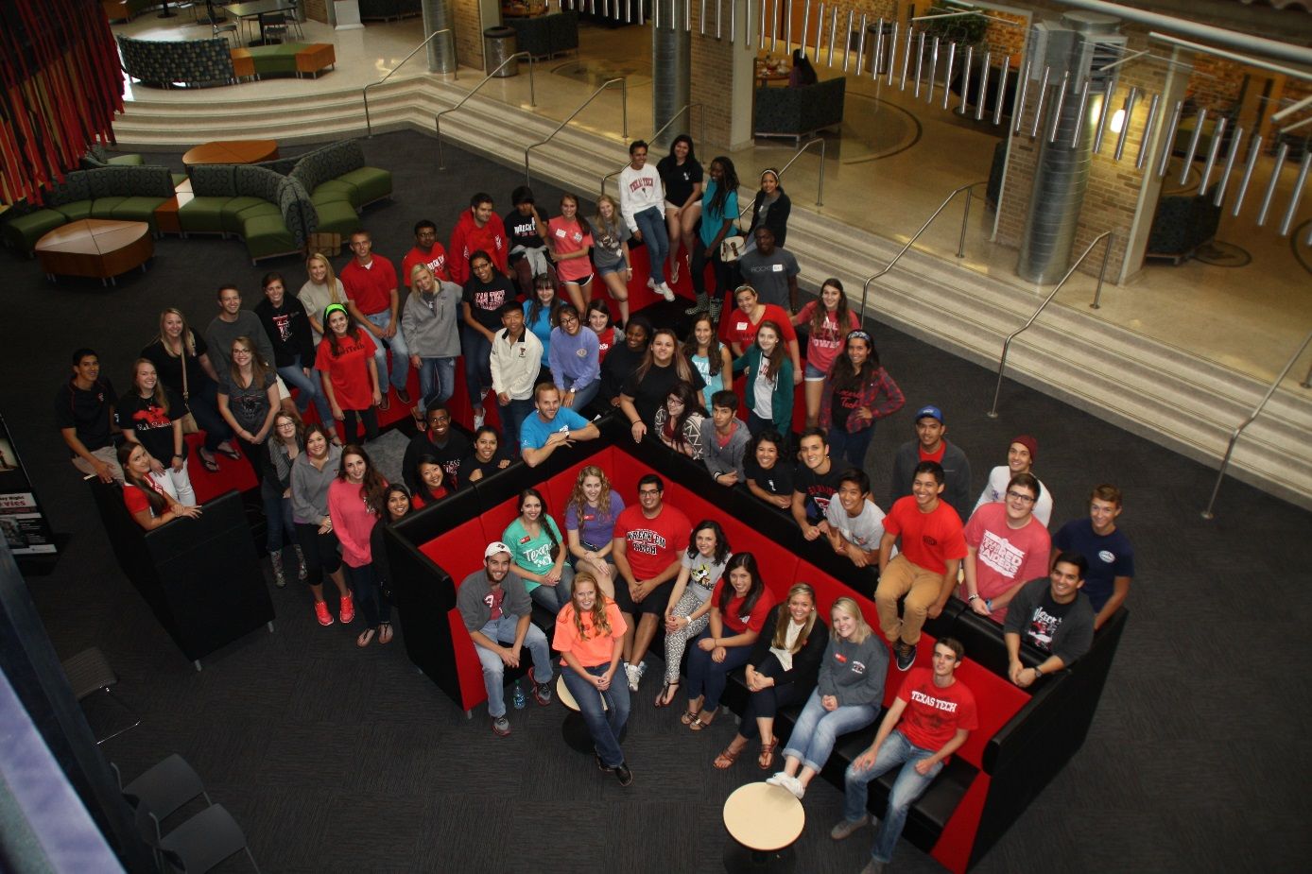
Texas Tech University
Student Union & Activities Statistical Analysis of Programs 2014-2015

Slide 2
Texas Tech University
Union Activities Assessment Data

Slide 3
Tech Activities Board (TAB)
Mission
The Tech Activities Board (TAB) is a group of student leaders dedicated to programming social, diverse, traditional, community outreach, and educational events to enhance each student’s individual experience at Texas Tech University.
History
The Tech Activities Board is the largest student programming board on campus and is responsible for planning quality events for the university community. TAB was founded in 1953 as the University Center Programming Board and reinvented in 2006, as TAB, to better serve and identify with the student population. Today, TAB plays a vital role in fostering and developing Red Raider spirit and traditions such as Homecoming, RaiderGate, Arbor Day, and in creating community on the Texas Tech campus.
Purpose
TAB strives to bring the best local, college, and national entertainment and educational programs to Texas Tech University. TAB offers students, faculty, staff, and community members’ diverse programming in support of the educational missions of the University while providing students with leadership training and hands-on learning as they select, plan, implement, and evaluate programs. All programs are offered free or at a reduced cost to Texas Tech students.

Slide 4
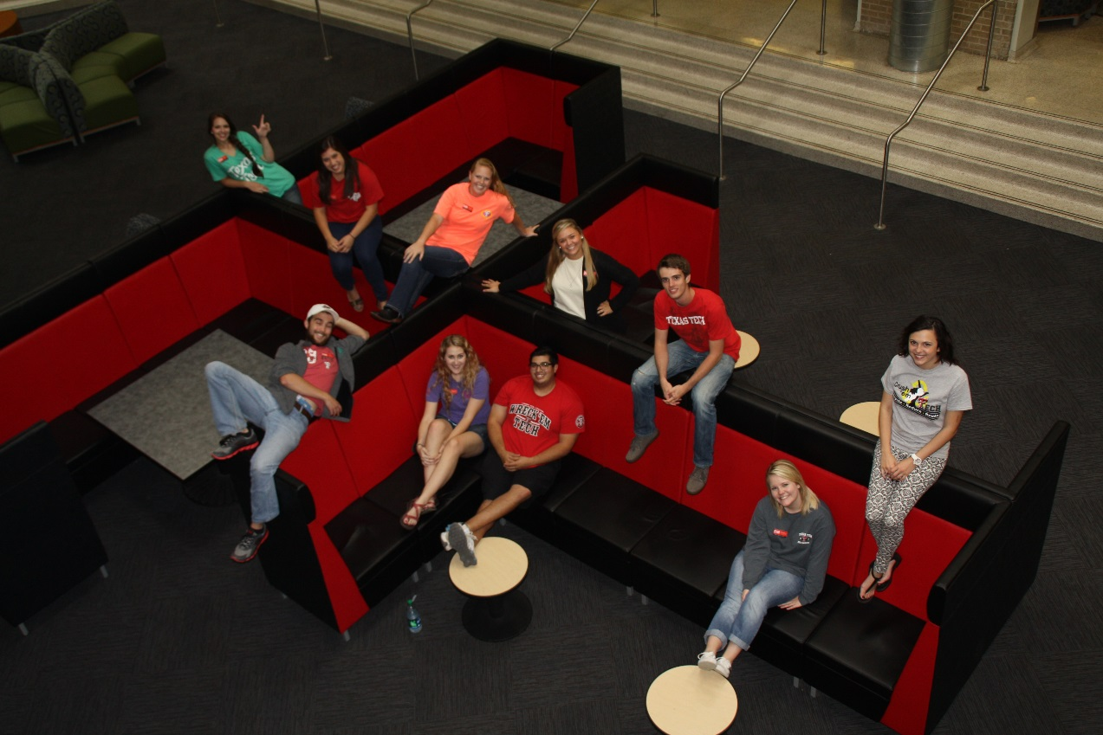
Tech Activities Board (TAB)
Fall 2014
TAB Leadership
President McKenzie Hopson
Vice President Communications & Marketing Matthew Martinez
Vice President Recruitment & Retention Kelcy Pierce
TAB Executive Board
Concerts Coordinator John Buie
Daytime Coordinator Colin Dublin
Films Coordinator Kristina Discher
Homecoming Coordinator Lisa Branson
Night Life Coordinator Adrianne Mandes
Outreach Coordinator Madeline Walker
Special Programs Coordinator Ani Mangold

Slide 5
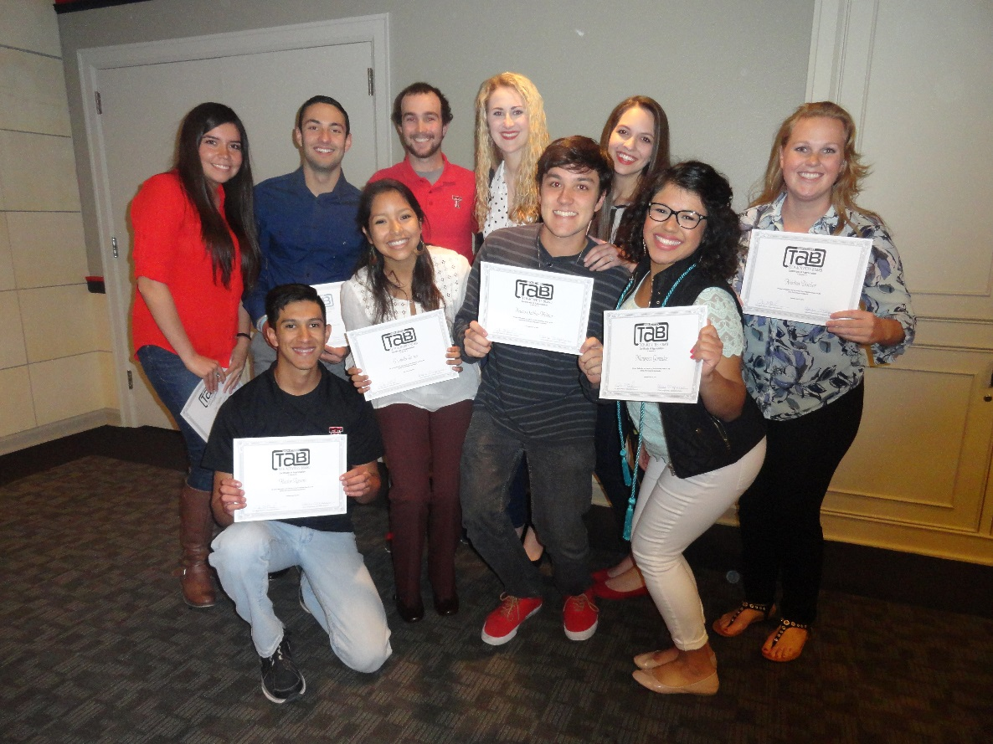
Tech Activities Board (TAB)
Spring 2015
TAB Leadership
President McKenzie Hopson
Vice President Communications & Marketing John Buie
Vice President Recruitment & Retention Kelcy Pierce
TAB Executive Board
Concerts Coordinator Marigrace Gonzales
Daytime Coordinator Lee Valdivia
Films Coordinator Kristina Discher
Homecoming Coordinator Hector Aguirre
Night Life Coordinator Gabriella Gamez
Outreach Coordinator Mario Yague
Special Programs Coordinator Bruno Saliba Helmer

Slide 6
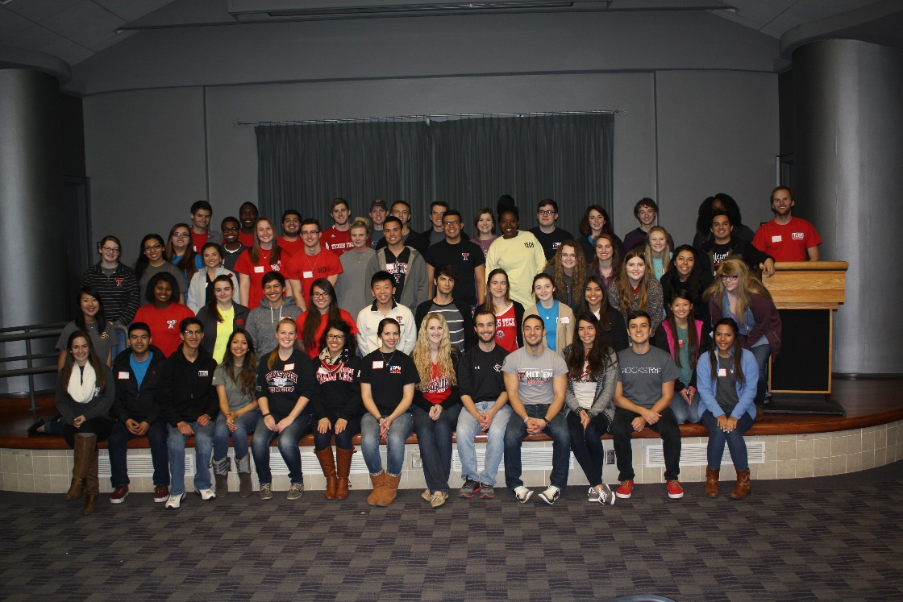
Tech Activities Board (TAB)
Tech Activities Board (TAB)
2014-2015
Classification
Freshman 28%
Sophomore 34%
Junior 28%
Senior 10%
Colleges Represented
College of Agricultural Sciences & Natural Resources 3%
College of Architecture 6%
College of Arts & Sciences 28%
Rawls College of Business 32%
College of Education 2%
College of Engineering 8%
College of Human Sciences 8%
College of Media & Communication 9%
Texas Tech Health Sciences Center Nursing 4%
Currently Employed
Yes 47%
No 53%
Other Student Organization Involvement
Yes 85%
No 15%
TAB Membership
Fall 2014 64 Board Members
Spring 2015 65 Board Members
Gender
Male 40%
Female 60%

Slide 7
Tech Activities Board (TAB)
TAB Committees
CONCERTS is responsible for planning and implementing various musical entertainment acts to campus for concert events like RaiderGate student tailgate tradition, Raider City Limits spring concert, and Arbor Day.
DAYTIME is responsible for planning and implementing a series of make-and-take events, novelties, and other home-grown activities during the lunch hour and throughout the day.
FILMS is responsible for screening movies throughout the semester, including new releases and classics, as well as hosting a night at Stars and Stripes Drive-In theatre and Dive-In movies at the Leisure Pool.
HOMECOMING is responsible for Texas Tech Homecoming Week programming, including various events such as Student Organization Sing, Pep Rally, Bonfire, Parade, and Homecoming Court, as well as any other programs related to Homecoming.
NIGHT LIFE is responsible for hosting live entertainment acts and speaker engagements in the evening and on weekends, including magicians, comedians, hypnotists, mentalists, lecturers, and more.
OUTREACH is responsible for community outreach programming and creating partnerships and connections on campus and in the greater Lubbock community, through programs including Service Week, Diversity Week, and monthly service opportunities.
SPECIAL PROGRAMS is responsible for planning special events on campus including volleyball tournaments, laser tag, and Murder Mystery Dinner, as well as off-campus excursions to the Corn Maize, Adrenaline City, and Cosmic Bowling.

Slide 8
Tech Activities Board (TAB)
Fall 2014 - Events Assessed
Indoor Volleyball Tournament
Dive-In Movie
Make Your Own Soap
Recruitment Social
Film: Maleficent
Adrenaline City
Karaoke Night
Volunteer Fair
Film: Edge of Tomorrow
Poetry Night
Open Mic Night
Comedian Michael Kent
Late Night Bowling
6 Minutes of Service: Inside Out Foundation
Film: Tammy
Old Time Western Photos
All Star Comedy Jam
Laser Battle
Make Your Own First Aid Kit
Film: 22 Jump Street
Mind Reader Eric Dittelman
Film: Guardians of the Galaxy
Corn Maize
Homecoming Star Print Cookies
Poetry Slam
Make Your Own Candle
Make Your Own Stocking
Open Mic Night
Sex Tape
Murder Mystery Dinner
Raider Games
Make Your Own Photo Mug
Flying Tortillas Improv
Make Your Own Stressball
All Day Film: Elf
Rest & Relaxation Night

Slide 9
Tech Activities Board (TAB)
Spring 2015 - Events Assessed
Condom Casino
Soup & Scoop
Inflatable Snow Globe Pictures
Homecoming Make Your Own Spirit Sign
Film: Fury
Treat Bags For Kids
Red Raider Swing
Make Your Own Desk Organizer
Mr. Gatti’s Night
Open Mic Night
Valentines for Vets
Reel Rock Film Festival/
Vertical Plains Climbing Competition
Comedian Jeffrey Jay
Film: Big Hero 6
Silent Disco
Make Your Own Street Sign
Singer/Songwriter Competition
Comedian Mike Palascak
Alamo Draft House Movie Night
Open Mic Night
Make Your Own Zen Garden
Karaoke Night
Light the Way Luminarias
Harry Potter House Cup Competition
Comedy Night
Hunger Games: Mocking Jay Part 1
Comedian Magician Joseph Tran
Make Your Own Lantern
Thunder Zone
Homecoming Make Your Own Bobble Head
Stars & Stripes Drive-In Movie
Red Raider Showcase
Pancakes for TWLOHA
Amazing Race
Make Your Own Plant in a Jar
Film: The Hobbit
Open Mic Night
Make Your Own Friendship Bracelet
Rest & Relaxation Night

Slide 10
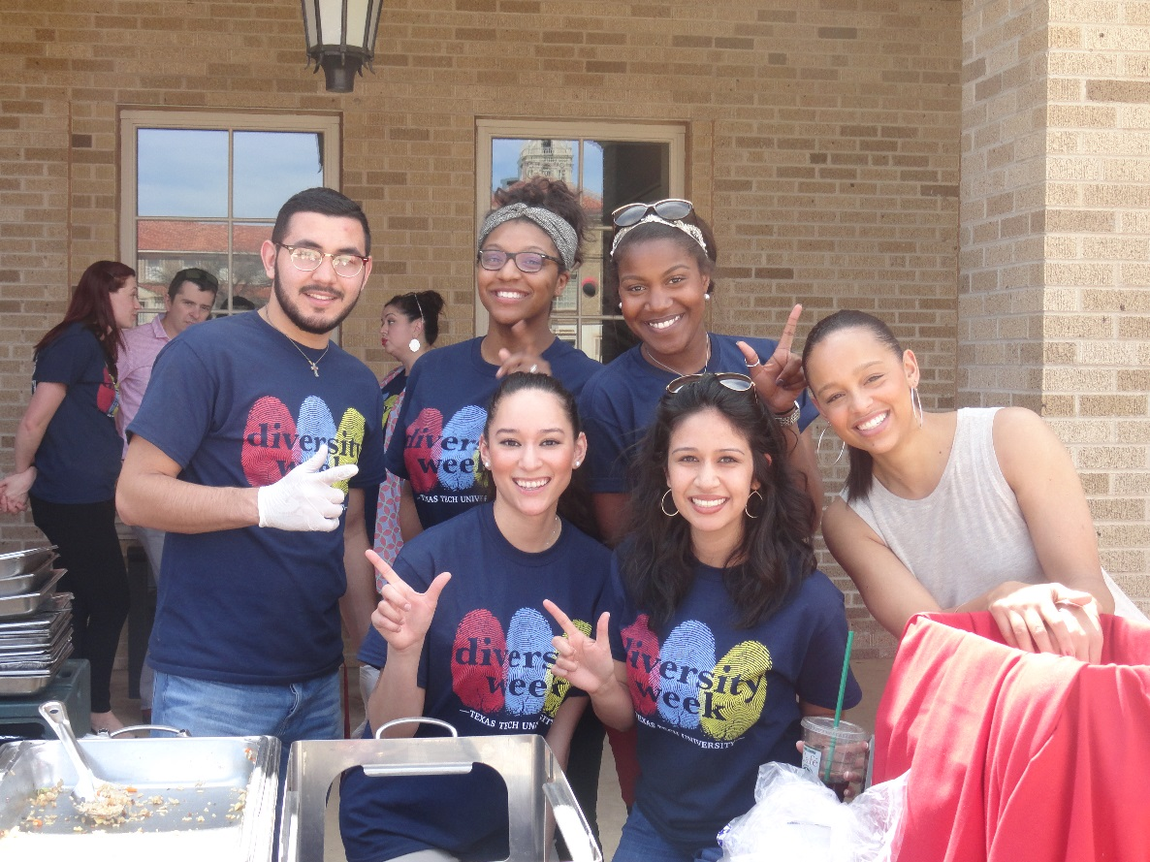
Tech Activities Board (TAB) Ethnicity
N= 666
The TAB evaluation asks participants to identity ethnicity to determine if TAB event attendance is reflective of the Texas Tech student population. Approximately 26% of the students were Hispanic/Latino, 12% of the attendees identified as African-American and 10% were Asian-American.

Slide 11
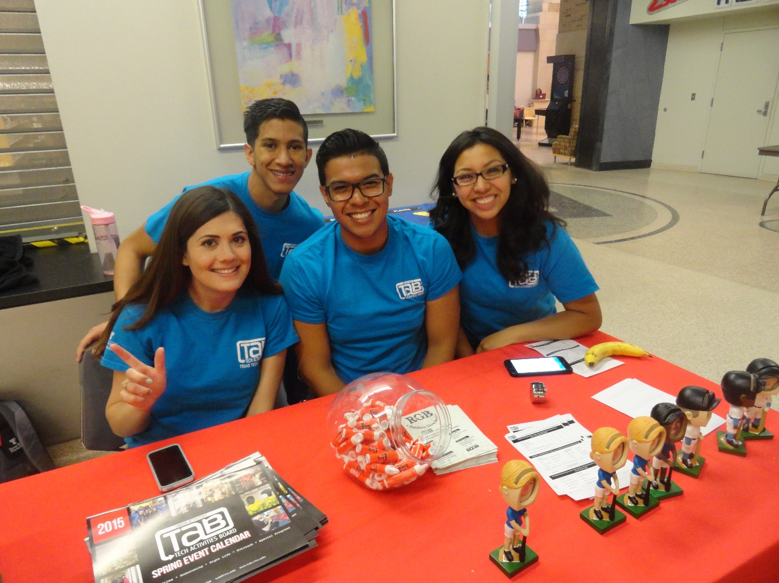
Tech Activities Board (TAB) Classification
N= 666
The evaluation asks participants to identity classification to determine how TAB is serving students of various classifications.

Slide 12
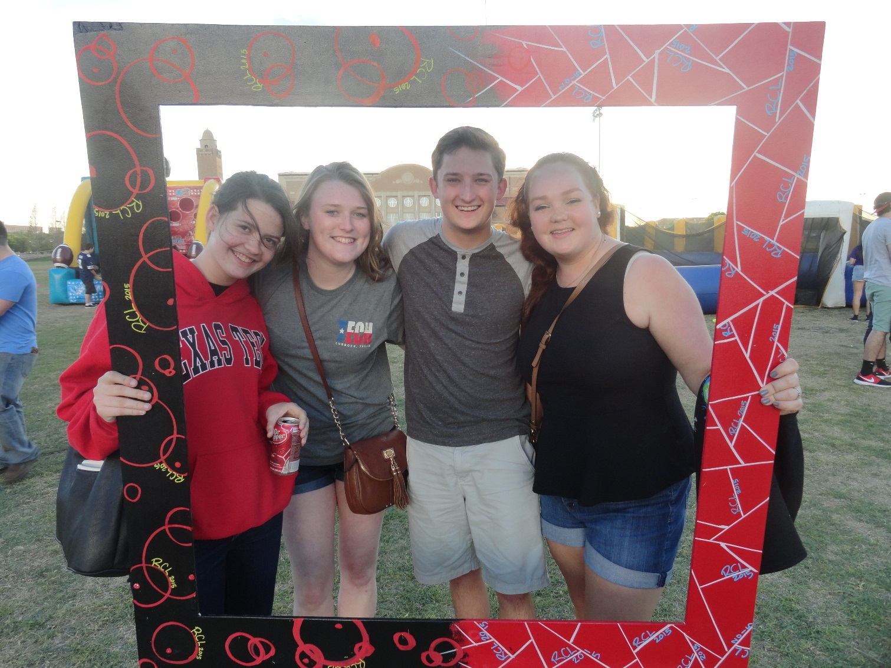
Tech Activities Board (TAB) Residency
Tech Activities Board tries to reach students living both on and off campus. This year, 55% of those surveyed indicated that they lived on-campus, while 45% indicated they live off-campus.
N= 666

Slide 13
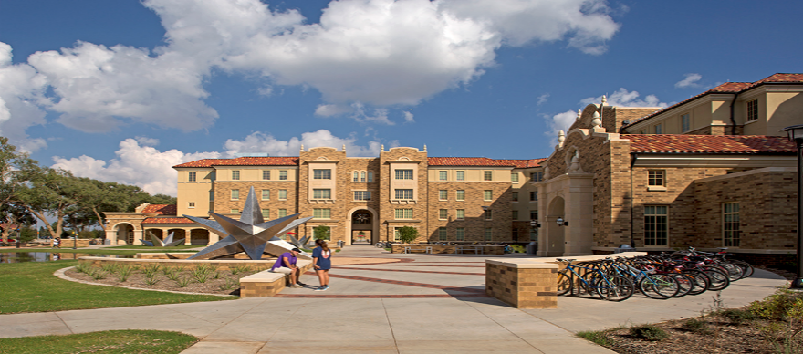
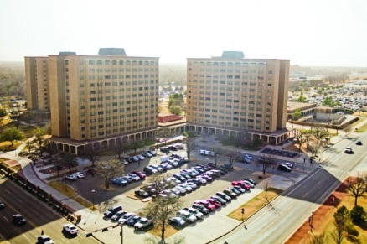
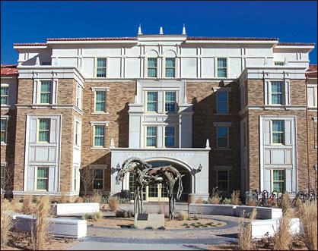
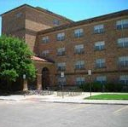
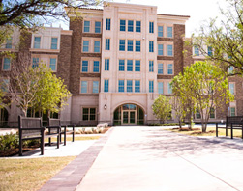
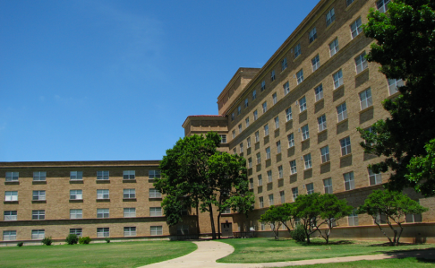
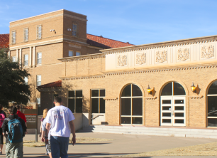
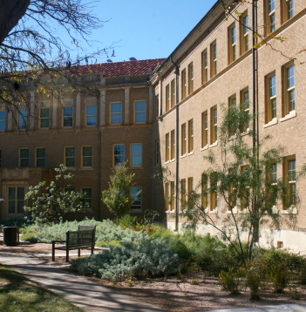
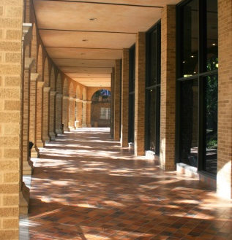
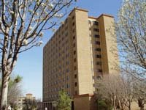
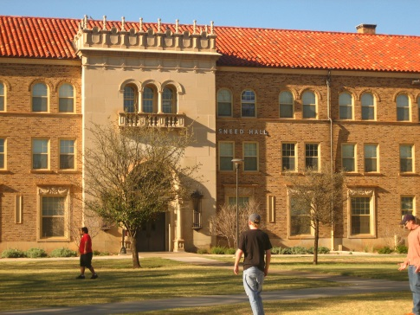
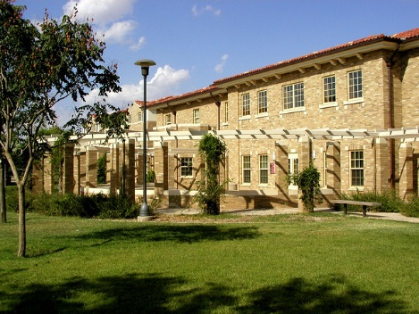
Tech Activities Board (TAB) On-Campus Residency
4%
13%
5%
11%
Chitwood/Weymouth Complex
West Village
4%
5%
9%
Murray Hall
Hulen/Clement Complex
Stangel/Murdough Complex
Gordon Hall
Talkington Hall
19%
10%
11%
3%
6%
Horn/Knapp Complex
Coleman Hall
Bledsoe/Sneed Hall
Carpenter/Wells Complex
Wall/Gates Complex

Slide 14
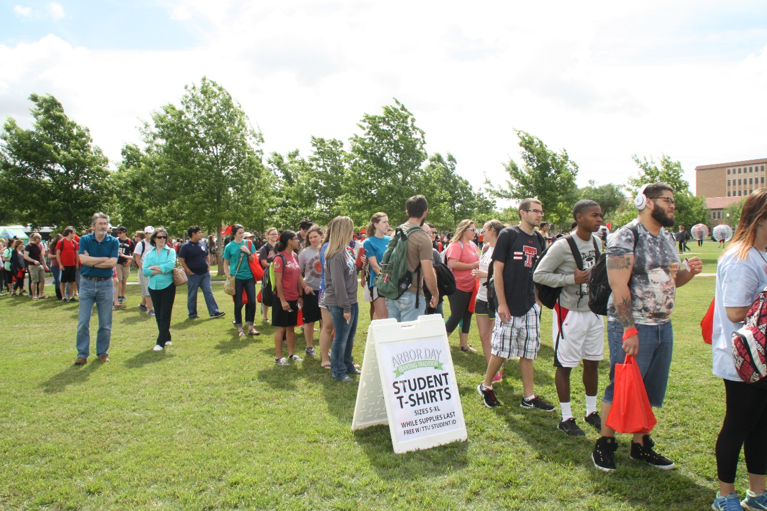
Tech Activities Board (TAB) Publicity
N= 666
After surveying the students, 45% believe that the marketing for TAB events was excellent. Roughly 70% of those surveyed identified that TAB event publicity is above average or better.

Slide 15
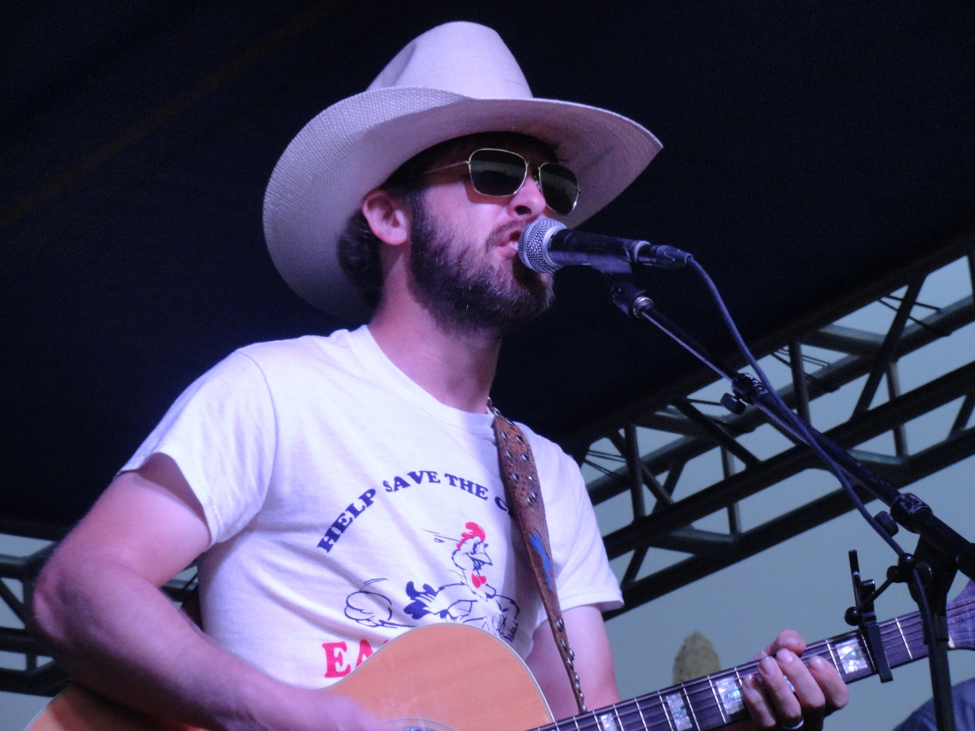
Tech Activities Board (TAB) Venue
N= 666
Students are pleased with the current locations for TAB events, with 89% of the students rating the venues as above average or better. TAB events take place in venues throughout the Student Union Building and in a variety of venues across campus.
N=666

Slide 16
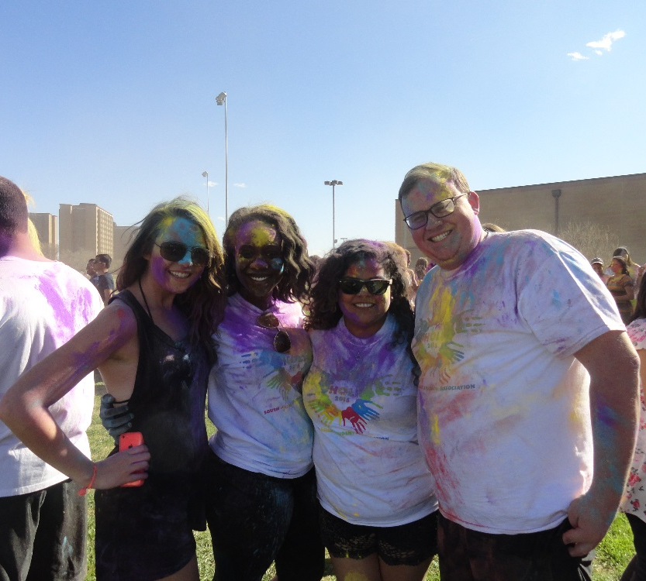
Tech Activities Board (TAB) Time
N= 666
The time for TAB events varies, with times that range from daytime to after hours. Students have different schedules and TAB tries to plan different event times throughout the day to accommodate the student needs.
N=666

Slide 17
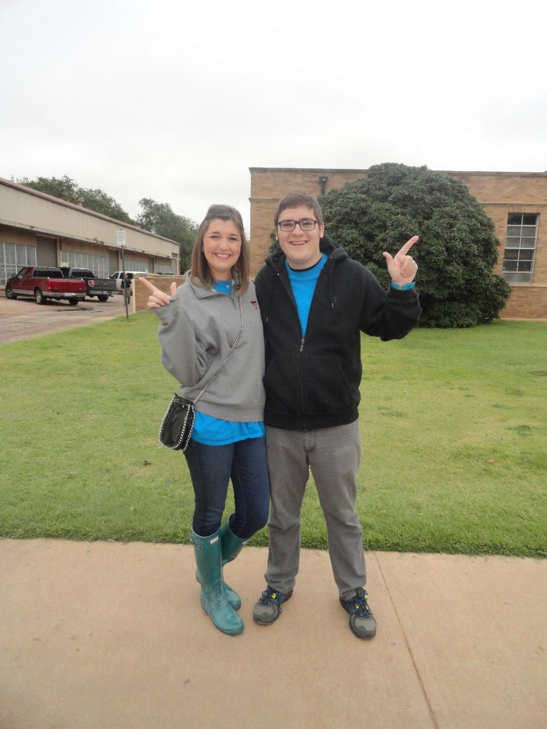
Tech Activities Board (TAB) Day of the Week
N= 666
Of those surveyed, 89% indicated that they were satisfied with TAB event dates. TAB takes this into consideration to encourage more students to attend events.

Slide 18
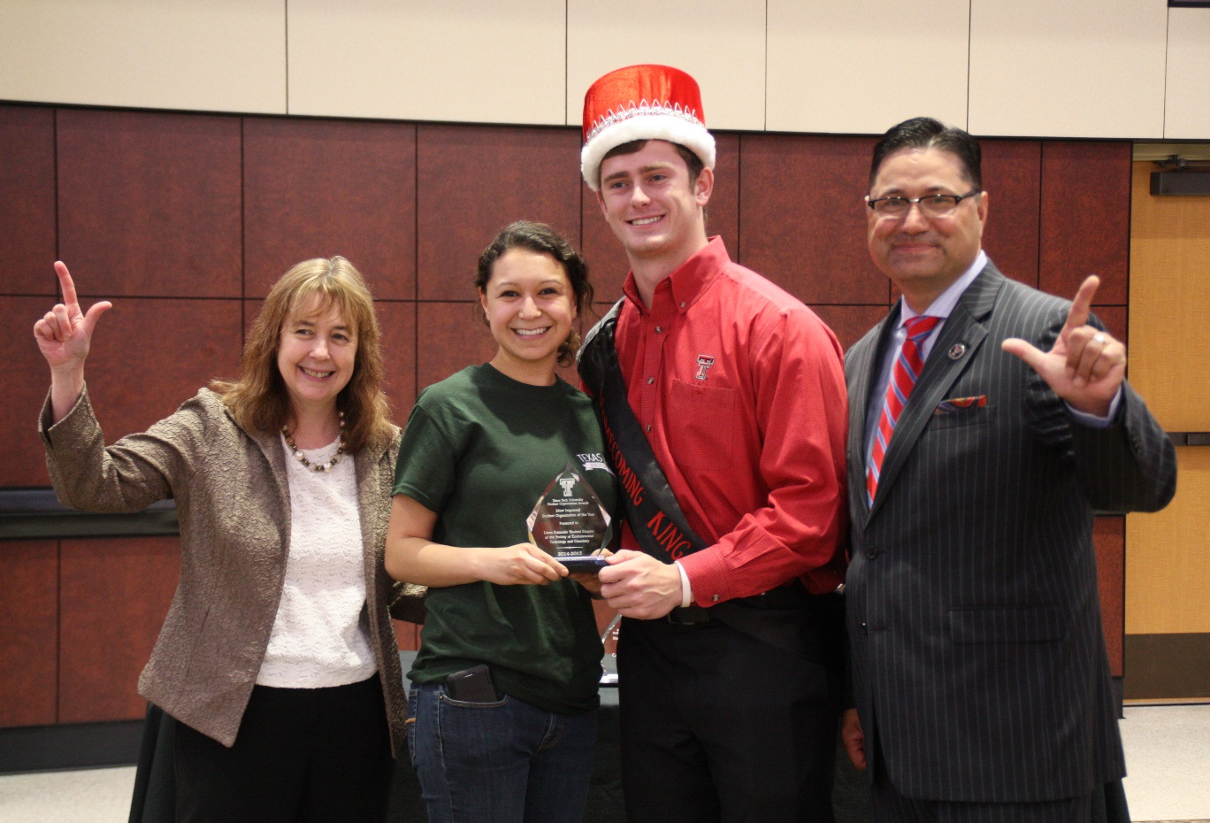
Tech Activities Board (TAB) Quality
N= 666
Of those surveyed, 92% indicated that they viewed the quality of TAB events as above average or excellent.

Slide 19
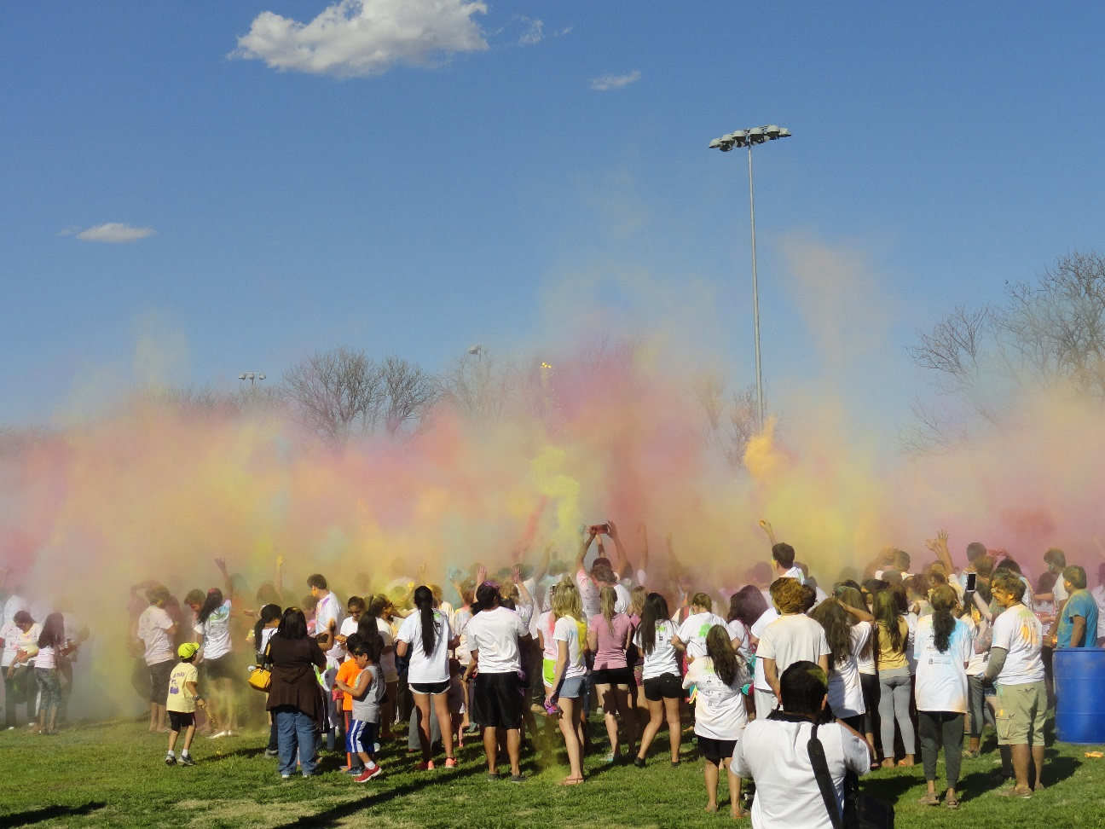
Tech Activities Board (TAB) Overall Satisfaction
N= 666
This is an important statistic from the evaluation. TAB’s goal is to be successful and create great events throughout the year. This year, 64% of individuals surveyed identified their overall satisfaction as excellent.

Slide 20
Tech Activities Board (TAB) Faculty Involvement
N= 666
The Tech Activities Board encourages faculty involvement by increasing faculty awareness of TAB events related to their curriculum. This year 5% of students were encouraged to attend a TAB event by their professor.

Slide 21
Tech Activities Board (TAB) How did you hear about this event?
The most common answer students give when asked “how did you hear about the event,” was from a friend, TAB posters and TechAnnounce. 10% did not respond to the question. This information will help TAB to determine the most effective marketing strategies to increase attendance at events.
N= 666
*Note: May include multiple responses

Slide 22
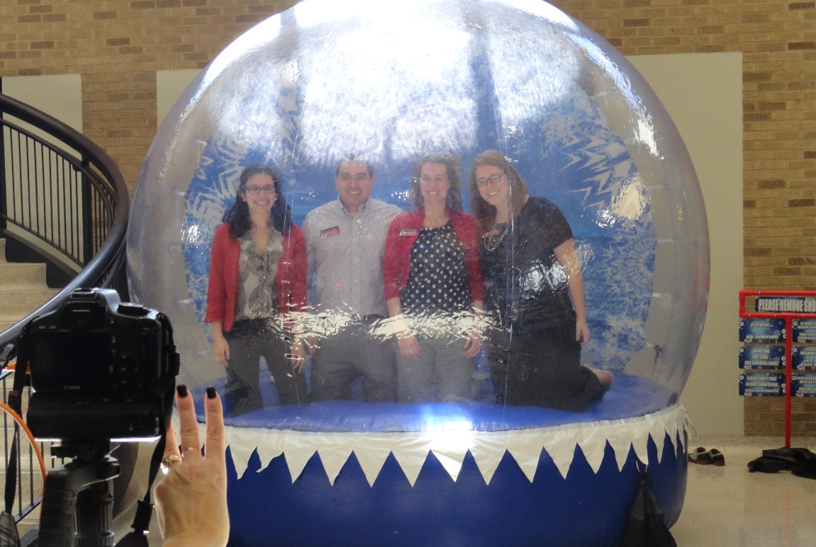
Tech Activities Board (TAB) What events would you like to see in the future?
The most requested events for this year were comedians, movies (new release), and concerts. Independent movies, game shows, and acoustic music were the next highest scoring categories.
N= 666
*Note: May include multiple responses

Slide 23
Tech Activities Board Attendance Numbers
 | 2013-2014 | 2014-2015
Total Attendance | 26,376 | 33,514
Honorarium Expenses | $144,976.12 | $132,258.39
Price Per Student | $5.47 | $3.90
Fall Events | 49 | 61
Spring Events | 46 | 51
Total Number of Events | 95 | 112

Slide 24
Tech Activities Board Attendance Per Month
 | Number of Events | Attendance | Honorarium Expenses
August | 8 | 2,853 | $12,545.25
September | 13 | 4,035 | $22,160
October | 25 | 10,168 | $30,936.79
November | 11 | 3,234 | $16,864.75
December | 4 | 418 | $2,020.61
January | 9 | 2,042 | $10,155.15
February | 13 | 1,547 | $14,541.57
March | 10 | 4,857 | $4,718.31
April | 15 | 4,062 | $22,926.60
May | 3 | 298 | $1,425.67
TOTAL | 112 | 33,514 | $132,258.39

Slide 25
Tech Activities Board (TAB)
Event Highlights
Homecoming Week
The theme of Homecoming Week 2014 was “Tech Goes Hollywood: Coming to a Screen Near You!” This year, the committee worked to change the schedule of events from hosting the parade on Saturday to now having it on Friday. Now the Friday night activities include parade, Pep Rally and Bonfire.
Raidergate
RaiderGate, a Student Tailgate Tradition was revamped this past year by a committee of students and staff who all have a vital role in football game day activities. The students were representative of key stakeholders on campus from TAB, RHA, SGA, Greek Life councils and the Graduate Student Council. The tradition was formatted to be more of a tailgating atmosphere prior to every home game and the previous concert format was removed from the schedule. An online reservation system was also created for students and student orgs to reserve spaces for every home game. Greenspace tailgating was implemented as well as the opportunity to have the SGA sponsor a venue at RaiderGate for the student body. Overall attendance increased for this past year and students were very satisfied with having the opportunity to have a consistent tailgating spot for every home game.
Notes:
Kickoff – 900
Scavenger Hunt – 30
SO Sing – 4100
RRR – 550
Spin Art Frisbees – 131
Inflatable Twister – 134
Spirit Board – 42
Spirit Banner – 36
Band March –
Pep Rally/Bonfire –
Techsan Memorial –
Techsan Memorial Dinner -

Slide 26
Tech Activities Board (TAB)
Event Highlights
Diversity Week
Diversity Week was a collaboration among TAB and 40 campus departments to host diversity-themed programming comprised of 40 events, including 5 week-long events, attended by over 3,250 Texas Tech students!
Service Week
This year TAB worked with Residence Hall Association to host Service Week. Service Week had five off-campus volunteer opportunities and five 6-Minutes of Service opportunities for students to come together to create something that will impact the community without even leaving campus.
Tech Can Share Food Drive
Tech Can Share was hosted with Rho Lambda, Order of Omega, Recreational Sports and Tejas Motors throughout the month of November. 1,152 pounds of food and approximately $140 were collected. Alpha Phi Omega was the winning Student Organization, Chi Omega was the winning Greek organization, and the Community, Family and Addiction Studies department was the winning campus department. All food and money were donated to South Plains Food Bank.
Notes:
Kickoff – 900
Scavenger Hunt – 30
SO Sing – 4100
RRR – 550
Spin Art Frisbees – 131
Inflatable Twister – 134
Spirit Board – 42
Spirit Banner – 36
Band March –
Pep Rally/Bonfire –
Techsan Memorial –
Techsan Memorial Dinner -

Slide 27
Tech Activities Board (TAB)
2014-2015
Student Union & Activities and Tech Activities Board gave away more than 7,200 FREE t-shirts this year.
The Student Union and Activities Twitter account was created in January 2015, with 96 followers 122 tweets and 29 retweets in the first few months.
TAB created a Tumblr account in 2015. @TTUTAB has 24 posts, 10 notes (likes), and 44 views from Twitter & Facebook posts
Notes:
Kickoff – 900
Scavenger Hunt – 30
SO Sing – 4100
RRR – 550
Spin Art Frisbees – 131
Inflatable Twister – 134
Spirit Board – 42
Spirit Banner – 36
Band March –
Pep Rally/Bonfire –
Techsan Memorial –
Techsan Memorial Dinner -

Slide 28
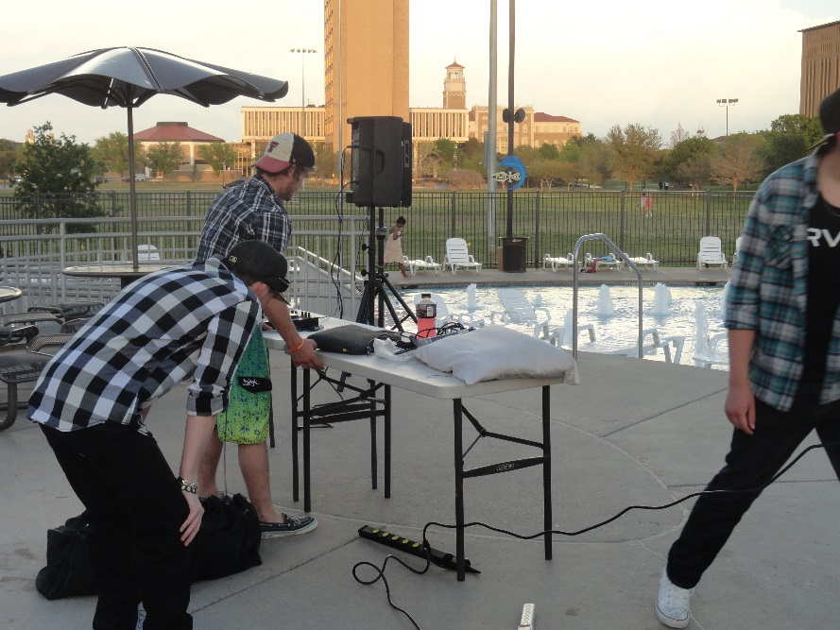
Tech Activities Board (TAB)
Collaborations 2014 - 2015
Fall 2014
Corn Maize
Flying Tortilla Improv Group
Homecoming
Indoor Volleyball Tournament
Night at the SUB
Poetry Night
RaiderGate
Service Week
Spring 2015
Arbor Day
Condom Casino
Diversity Week
Raider City Limits
Red Raider Showcase
Red Raider Swing
Reel Rock Film Festival & Vertical Plains Climbing Competition
Stars and Stripes: Drive-In Movie
TWLOHA $1 Pancake Day

Slide 29
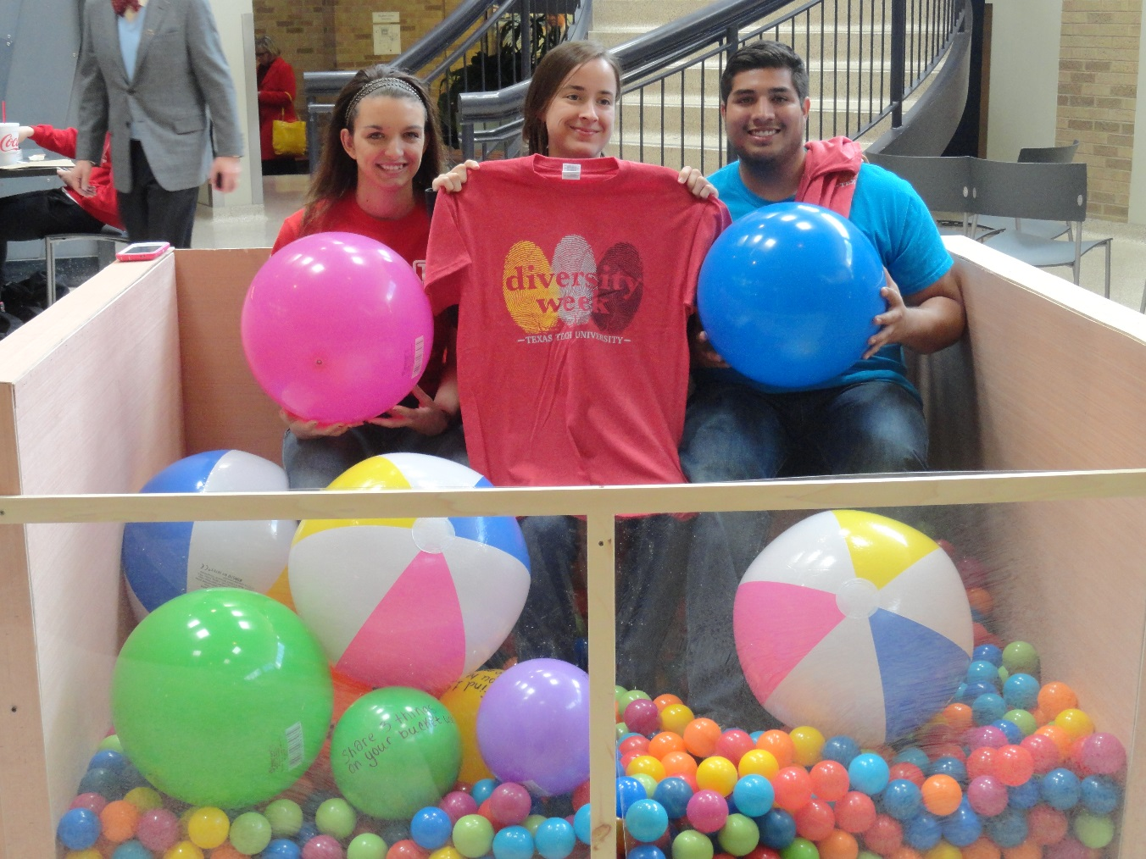
Union Activities
Lubbock Advertising Federation Marketing Awards
GOLD ADDY Award Winner 2015
Diversity Week, T-Shirt Design

Slide 30
Union Activities
Other Awards
Scholarship
Schubert Family Programming Scholarship recipient: Marcos Solis and Evonne Heredia
Barnes & Noble Scholarship: Priscilla Ipina
Tech Activities Board Annual Awards
Jerry V. Fox, Jr. Award for Outstanding Coordinator: Bruno Saliba Helmer
Award for Outstanding New General Member: Lindsay Williams
James G. Allen Award for Outstanding General Member: Alex Ann Miller
W.B. Rushing Award for Outstanding Contribution to Campus Programs: McKenzie Hopson
Advisor’s Choice Excellence Award: Caitlyn Butler
TABtime Achievement Award: Monica Cowie

Slide 31
Union Activities
Student Development
Student Development
Graduate Assistants: Skiler Miller and Jameson Nogowski
2014 I-LEAD: McKenzie Hopson, Kelcy Pierce and Lisa Branson
2015 NACA National Conference: Jameson Nogowski
Students
Hector Aguirre
John Buie
Caitlin Butler
Alex Ann Miller
Bruno Saliba Helmer
Lindsay Williams
Mario Yague

Slide 32
Hart Institute for Social Event Planning 2014
Union Activities
Professional Development
New Century Leadership
New Century Leadership is a leadership development and community orientation program for local high school juniors. New Century Leadership is designed to teach Lubbock area youth about the importance of personal and community responsibility.
Leadership Lubbock
Leadership Lubbock has continued to provide an outstanding leadership and community orientation program for selected Chamber business leaders. Created especially for the busy professional, Leadership Lubbock participants focus on developing leadership skills to improve connections in their professions.
Conference Attendance
2014 Big XII, Big 10, Pac 12 Directors Conference: Jon Mark Bernal, Matt Ducatt, Bill Brannan
2015 ACUI Annual Conference: Jon Mark Bernal
2015 NACA National Conference: Claire Maginness, Jon Mark Bernal, & Kimberly Simon-Akins
2015 American College Health Association Annual Meeting: Kimberly Simon-Akins
2015 NIRSA/ACUI Marketing Conference: Autumn Arthur
2015 Green Zone Training: Anneliese Bustillo

Slide 33
Tech Activities Board (TAB) Student Leader Learning Outcomes
Student Leader Learning Outcomes Assessment
TAB Leadership and Executive Board members participated in a pre-assessment and post-assessment, self-identifying a variety of learning outcomes along a Likert scale ranging from strongly agree to strongly disagree.
The following six slides reflect the change between pre-assessment and post-assessment data associated with these leadership, decision-making and problem-solving, planning and organization, assessment and evaluation, communication, time and stress management, and financial management learning outcomes, as reported by TAB Executive Board as a collective.
*The following information only reflects the 4 returning exec members due to turn over between fall and spring.

Slide 34
Tech Activities Board (TAB) Exec Board Learning Outcomes
LEADERSHIP
 | Learning Outcome | Year Score
1 | I have the ability to persuade or influence effectively. | +1
2 | I take initiative. | +3
3 | I delegate tasks. | +2
4 | I manage meetings effectively. | +5
5 | I am able to teach various skills. | +1
6 | I motivate others in an organization. | +2
7 | I evaluate skills and knowledge of other individuals. | +3
8 | I confront problems. | +3
9 | I exercise authority when needed. | +5
10 | I work independently. | -3
11 | I foresee problems and take appropriate action. | +2
12 | I am aware of my strengths as a leader. | +2
13 | I am aware of my weaknesses as a leader. | +2
14 | I can effectively recruit, retain and recognize team members. | +4
n=4

Slide 35
Tech Activities Board (TAB) Exec BoardLearning Outcomes
DECISION-MAKING AND PROBLEM-SOLVING
 | Learning Outcome | Year Score
15 | I identify issues and their cause/effect. | -1
16 | I mediate in times of dissension. | +3
17 | I reach logical decisions. | +2
18 | I implement decisions. | +3
19 | I deal objectively with situations and people. | +1
20 | I take responsibility for my actions. | +1
21 | I do not procrastinate. | +2
22 | I have an understanding of effecting conflict management. | +2
23 | I believe that my actions reflect sound and ethical decisions. | +4
n=4

Slide 36
Tech Activities Board (TAB) Exec Board Learning Outcomes
PLANNING AND ORGANIZATION
 | Learning Outcome | Year Score
24 | I set goals and specific objectives to meet those goals. | +3
25 | I develop a plan of action to obtain goals and objectives. | +1
26 | I evaluate progress towards the goal upon its completion. | +3
27 | I organize projects into manageable parts and processes. | +2
28 | I set and meet deadlines. | +3
29 | I am knowledgeable of trends in the campus culture | +1
30 | I am aware of the steps involved in event planning. | +5
31 | I know how to organize a major event on campus. | +4
32 | I am knowledgeable of different methods to promote an event. | +3
n=4

Slide 37
Tech Activities Board (TAB) Exec Board Learning Outcomes
ASSESSMENT AND EVALUATION
 | Learning Outcome | Year Score
33 | I know how to use and collect quantitative data for an event. | +3
34 | I know how to use and collect qualitative date for an event. | +2
35 | I know how to evaluate and reflect on an event. | +4
36 | I know how to benchmark with other programming boards and universities. | +5
n=4

Slide 38
Tech Activities Board (TAB) Exec Board Learning Outcomes
COMMUNICATION
 | Learning Outcome | Year Score
37 | I give clear instructions | +4
38 | I listen empathetically. | 0
39 | I have a command of written English. | +1
40 | I have a command of verbal English. | +1
41 | I have a command of e-mail and text messaging. | 0
42 | I can give constructive feedback. | +3
43 | I can accept feedback in an appropriate manner. | +2
44 | I feel confident speaking in front of large groups. | +3
45 | I am comfortable interviewing for campus leader positions. | +4
46 | I seek out my advisor for advice about my programming position. | +1
47 | I seek out my advisor for advice about academics and/or my personal life. | +2
n=4

Slide 39
Tech Activities Board (TAB) Exec Board Learning Outcomes
TIME AND STRESS MANAGMENT
 | Learning Outcome | Year Score
48 | I work effectively under pressure. | +2
49 | I exhibit effective means of coping with stress. | +4
50 | I effectively manage my time. | +3
51 | I make immediate logical decisions. | +5
52 | I create a balance between academic, employment, and co-curricular activities. | +3
FINANCIAL MANAGEMENT
 | Learning Outcome | Year Score
53 | I can read and analyze a budget. | +2
54 | I accept financial responsibility and work within a budget. | +3
n=4

Slide 40
Tech Activities Board (TAB) Exec Board Learning Outcomes
ADAPTABILITY
 | Learning Outcome | Year Score
55 | I can read and analyze a budget. | +1
56 | I accept financial responsibility and work within a budget. | +2
57 | I react well to change. | +4
HUMAN RELATIONS
 | Learning Outcome | Year Score
58 | I demonstrate a cooperative spirit. | +1
59 | I try to understand the varying backgrounds and lifestyles of others. | +0
60 | I respond to the needs of my peers/colleagues. | +2
61 | I actively educate myself in different cultures. | +4
62 | I cultivate relationships with others different from myself. | +2
n=10

Slide 41
Contributors
Jon Mark Bernal, Associate Director Kristin Miller, Senior Business Assistant
Kimberly Simon-Akins, Assistant Director Rhonda Bratcher, Specialist III
Autumn Arthur, Unit Manager Skiler Miller, Graduate Assistant
Claire Maginness, Unit Coordinator Jameson Nogowski, Graduate Assistant
Anneliese Bustillo, Unit Coordinator
Kelsey Holt, Temporary Worker
Data compiled by Skiler Miller & Jameson Nogowski
Graduate Assistants for Student Union & Activities

