Slide 1
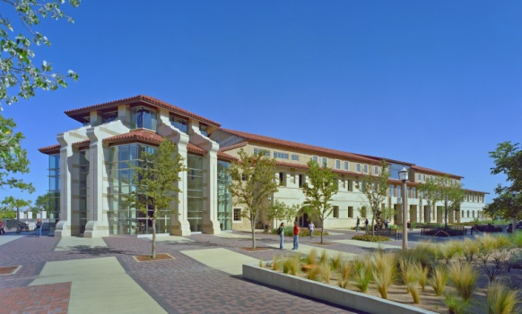
Texas Tech University
Student Union & Activities Statistical Analysis of Programs 2013-2014

Slide 2
Texas Tech University
Union Activities Assessment Data

Slide 3
Tech Activities Board (TAB)
Mission
The Tech Activities Board (TAB) is a group of student leaders dedicated to programming social, diverse, traditional, community outreach, and educational events to enhance each student’s individual experience at Texas Tech University.
History
The Tech Activities Board is the largest student programming board on campus and is responsible for planning quality events for the university community. TAB was founded in 1953 as the University Center Programming Board and reinvented in 2006, as TAB, to better serve and identify with the student population. Today, TAB plays a vital role in fostering and developing Red Raider spirit and traditions such as Homecoming, RaiderGate, Arbor Day, and in creating community on the Texas Tech campus.
Purpose
TAB strives to bring the best local, college, and national entertainment and educational programs to Texas Tech University. TAB offers students, faculty, staff, and community members’ diverse programming in support of the educational missions of the University while providing students with leadership training and hands-on learning as they select, plan, implement, and evaluate programs. All programs are offered free or at a reduced cost to Texas Tech students.

Slide 4
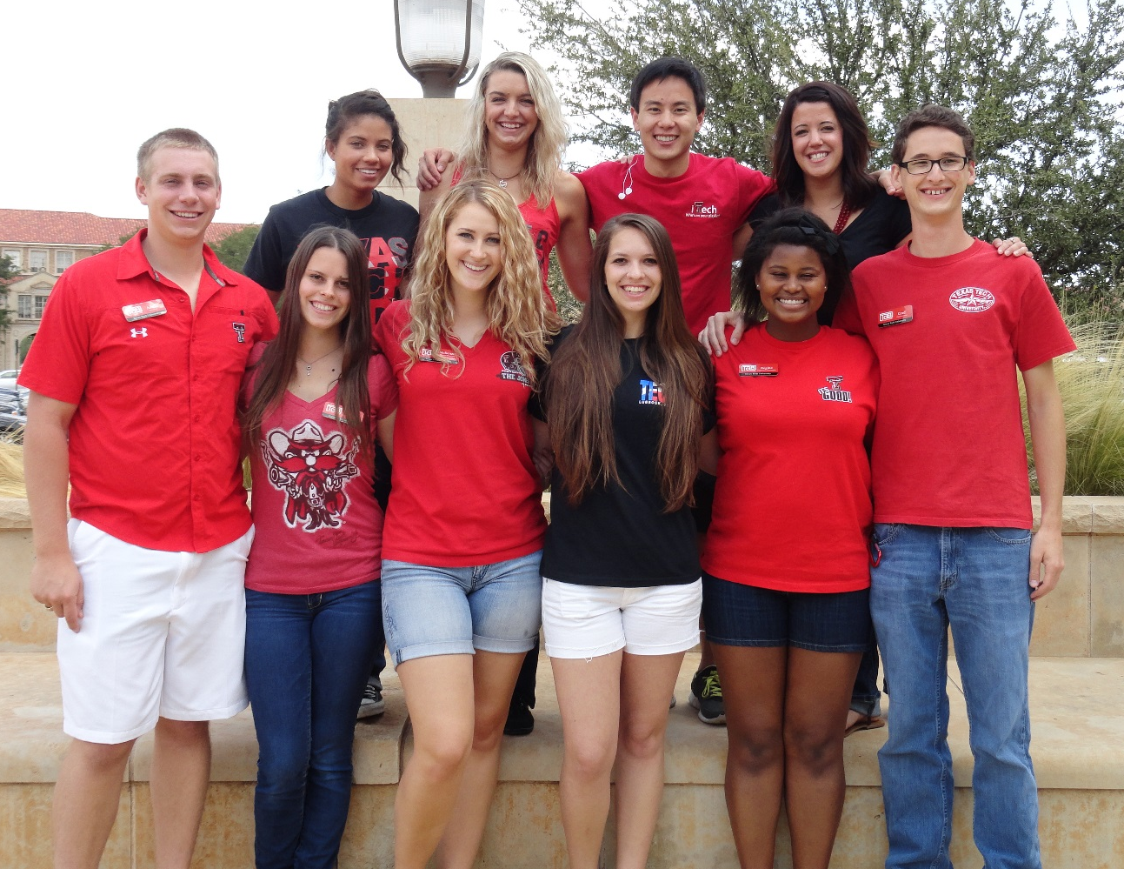
Tech Activities Board (TAB)
2013-2014
TAB Leadership
President Austin Reiter
Vice President Communications & Marketing Cord Scorgie
Vice President Recruitment & Retention Mackenzie Davidson
TAB Executive Board
Concerts Coordinator AJ Avery
Daytime Coordinator Kelcy James
Films Coordinator Savana Poe
Homecoming Coordinator Eric Lee
Homecoming Coordinator-Elect Lisa Branson
Nightlife Coordinator Regine Cliatt
Outreach Coordinator Natalie Butler
Special Programs Coordinator McKenzie Hopson

Slide 5
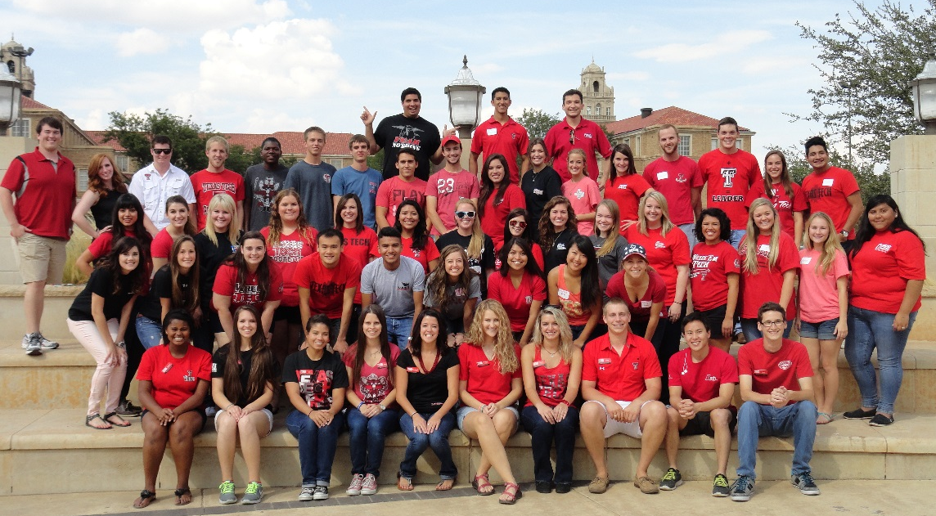
Tech Activities Board (TAB)
Tech Activities Board (TAB)
2013-2014
Classification
Freshman 21%
Sophomore 26%
Junior 32%
Senior 21%
Major (Grouped by Respective Colleges)
Agricultural Sciences & Natural Resources 4%
Architecture 2%
Arts & Sciences 23%
Business Administration 24%
Education 7%
Engineering 9%
Human Sciences 19%
Mass Communication 10%
Health Sciences Center Nursing 2%
Currently Employed
Yes 50%
No 50%
Other Student Organization Involvement
Yes 64%
No 36%
TAB Membership
Fall 2013 64 Board Members
Spring 2014 59 Board Members
Gender
Male 36%
Female 64%

Slide 6
Tech Activities Board (TAB)
TAB Committees
CONCERTS is responsible for planning and implementing various musical entertainment acts to campus for concert events like RaiderGate student tailgate, Raider City Limits spring concert, and Arbor Day.
DAYTIME is responsible for planning and implementing a series of make-and-take events, novelties, and other home-grown activities during the lunch hour and throughout the day.
FILMS is responsible for screening movies throughout the semester, including new releases and classics, as well as hosting a night at Stars and Stripes Drive-In theatre and Dive-In movies at the Leisure Pool.
HOMECOMING is responsible for Texas Tech Homecoming Week programming, including various events such as Student Organization Sing, Pep Rally, Bonfire, Parade, and Homecoming Court, as well as any other programs related to Homecoming.
NIGHTLIFE is responsible for hosting live entertainment acts and speaker engagements in the evening and on weekends, including magicians, comedians, hypnotists, mentalists, lecturers, and more.
OUTREACH is responsible for community outreach programming and creating partnerships and connections on campus and in the greater Lubbock community, through programs including Service Week, Diversity Week, and monthly service opportunities.
SPECIAL PROGRAMS is responsible for planning special events on campus including volleyball tournaments, laser tag, and Murder Mystery Dinner, as well as off-campus excursions to the Corn Maize, Adrenaline City, and Cosmic Bowling.

Slide 7
Tech Activities Board (TAB)
Fall 2013 - Events Assessed
Make Your Own Air Freshener
Comedy Night ft. Sammy Obeid & Melissa Villasenor
Indoor Volleyball Tournament
Dive-In Movie
Poster Sale
Stamp-A-Ring
The Great Gatsby
Alternative Fuels Improv
Adrenaline City
RaiderGate ft. Joey Green Band
Monster’s University
Karaoke Night
Volunteer Fair
Blood Drive
TCU Tailgate
Cupcake Wars
Movie in the Park - Iron Man
Make Your Own Dog Tag
Craig Karges, Magician & Mentalist
2 Guns
Interactive Game Night
Homecoming Kickoff
Homecoming Scavenger Hunt
Spin Art Frisbee
Student Organization Sing
Inflatable Twister
Techsan Memorial
Rowdy Raider Rally
Pep Rally & Bonfire
RaiderGate ft. William Clark Green
Make Your Own Emergency Bracelet
Comedy Night ft. Gina Brillon & Vladimir Caamano
The Conjuring
Corn Maize
Open Mic Night
Poetry Slam
Movie Monster Photos
RaiderGate ft. Six Market Boulevard
The Mud Room
We’re The Millers
Do You Remember Being a Fifth Grader
RaiderGate ft. Tyler and the Tribe
Drinking Buddies
Open Mic Night
Tom DeLuca, Hypnotist
Make Your Own Ornament
Murder Myster Dinner
All Day Movie – The Gremlins
Rest & Relaxation Night

Slide 8
Tech Activities Board (TAB)
Spring 2014 - Events Assessed
“Before I Graduate” Wall
Make Your Own Travel Mug
Fire & Ice Festival
Comedy Night ft. Cocoa Brown
Indoor Volleyball Tournament
Poster Sale
About Time
Mr. Gatti’s Night
Poetry Slam
Open Mic Night
Blood Drive
Mashed Potato Mash-terpieces
Reel Rock Film Festival/
Vertical Plains Climbing Competition
Valentine’s Themed Karaoke Night
Catching Fire
Matador Mashup
Superhero Photos
Matt Grisham, Hypnotist
Skate Night
Make Your Own Fish Tank
Thor
Red Raider Showcase Auditions
Poolapoolooza
Open Mic Night
Karaoke Night
Gravity
Decorate Your Own Cookie
Harry Potter House Cup Competition
Singer/Songwriter Competition
Make Your Own Piggy Bank
Spirit Scavenger Hunt
Flying Tortillas Improv
Pop Art Pics
Drive-In Movie
Raider City Limits ft. Crash Kings
Diversity Week
Lone Survivor
Texas Tech Traditions Photo Op
Red Raider Showcase
Arbor Day
Return to Mogadishu
Operation Care Package
Capture the Flag
Batalla de Puebla: Cinco de Mayo
All Day Movie – Frozen
Rest & Relaxation Night

Slide 9
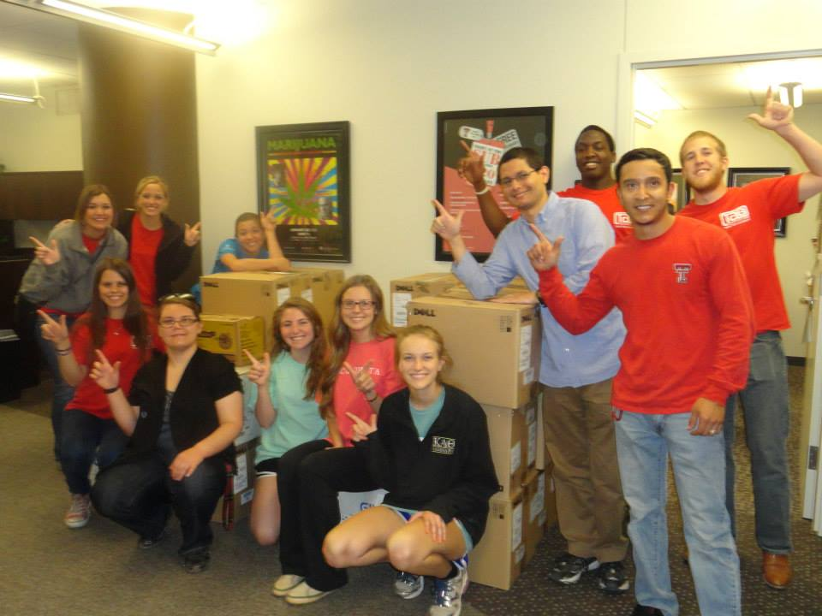
Tech Activities Board (TAB) Ethnicity
N= 666
The TAB evaluation asks participants to identity ethnicity to determine if TAB event attendance is reflective of the Texas Tech student population. Approximately 24% of the students were Hispanic/Latino, 13% of the attendees identified as African-American and 6% were Asian-American.

Slide 10
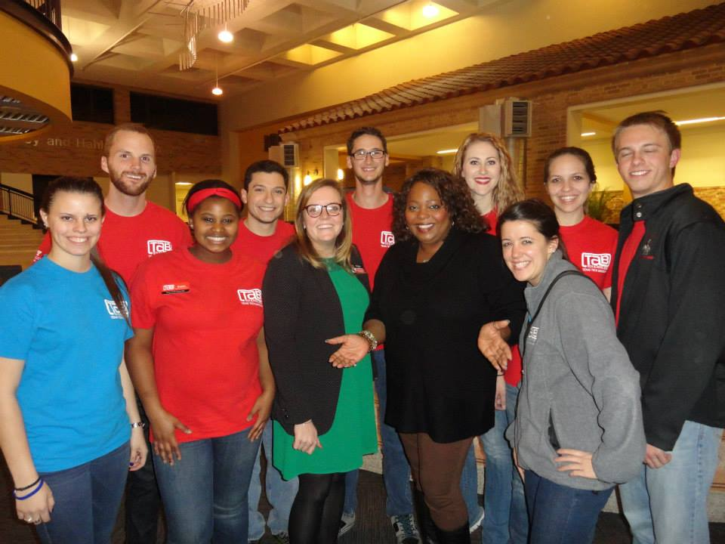
Tech Activities Board (TAB) Classification
N= 666
The evaluation asks participants to identity classification to determine how TAB is serving students of various classifications.

Slide 11
Tech Activities Board (TAB) Residency
N= 666
Tech Activities Board tries to reach students living both on and off campus. This year, 48% of those surveyed indicated that they lived live on-campus, while 37% indicated they live off-campus.

Slide 12
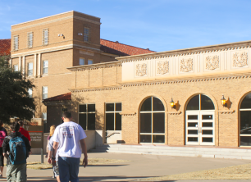
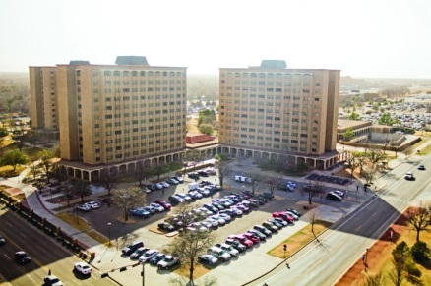
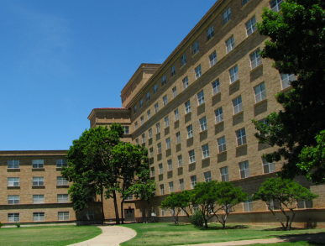
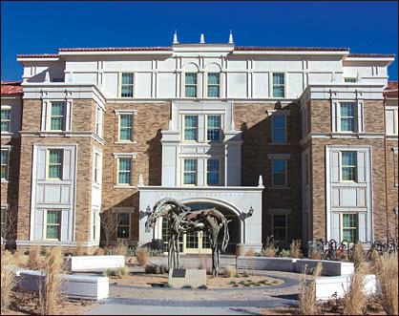
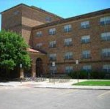
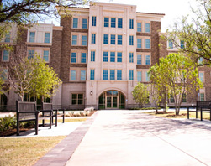
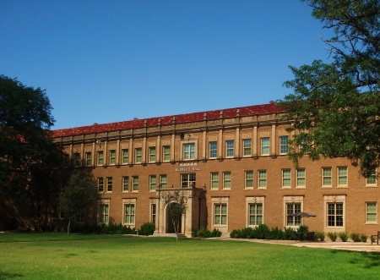
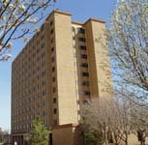
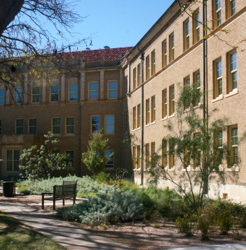
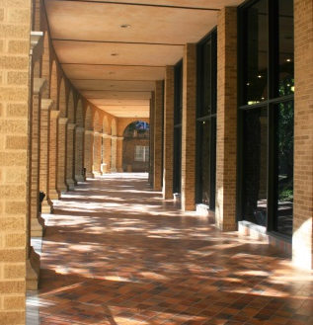
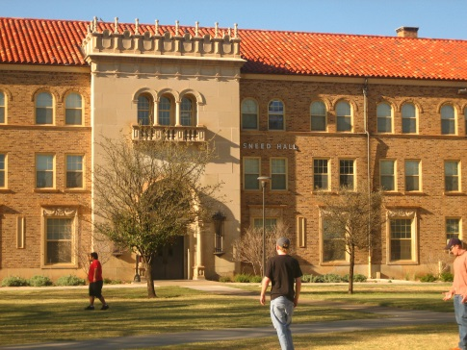
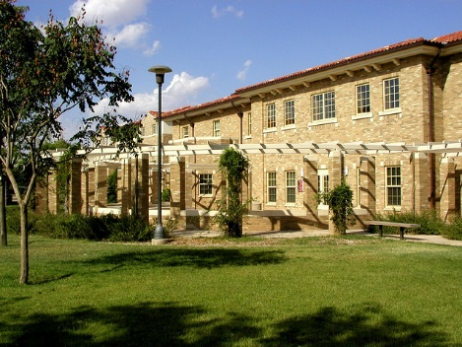
Tech Activities Board (TAB) On-Campus Residency
5%
13%
12%
6%
12%
Gordon Hall
Chitwood/Weymouth Complex
4%
5%
Stangel/Murdough Complex
Murray Hall
Hulen/Clement Complex
Talkington Hall
Bledsoe Hall
14%
4%
18%
4%
4%
Horn/Knapp Complex
Coleman Hall
Sneed Hall
Carpenter/Wells Complex
Wall/Gates Complex

Slide 13
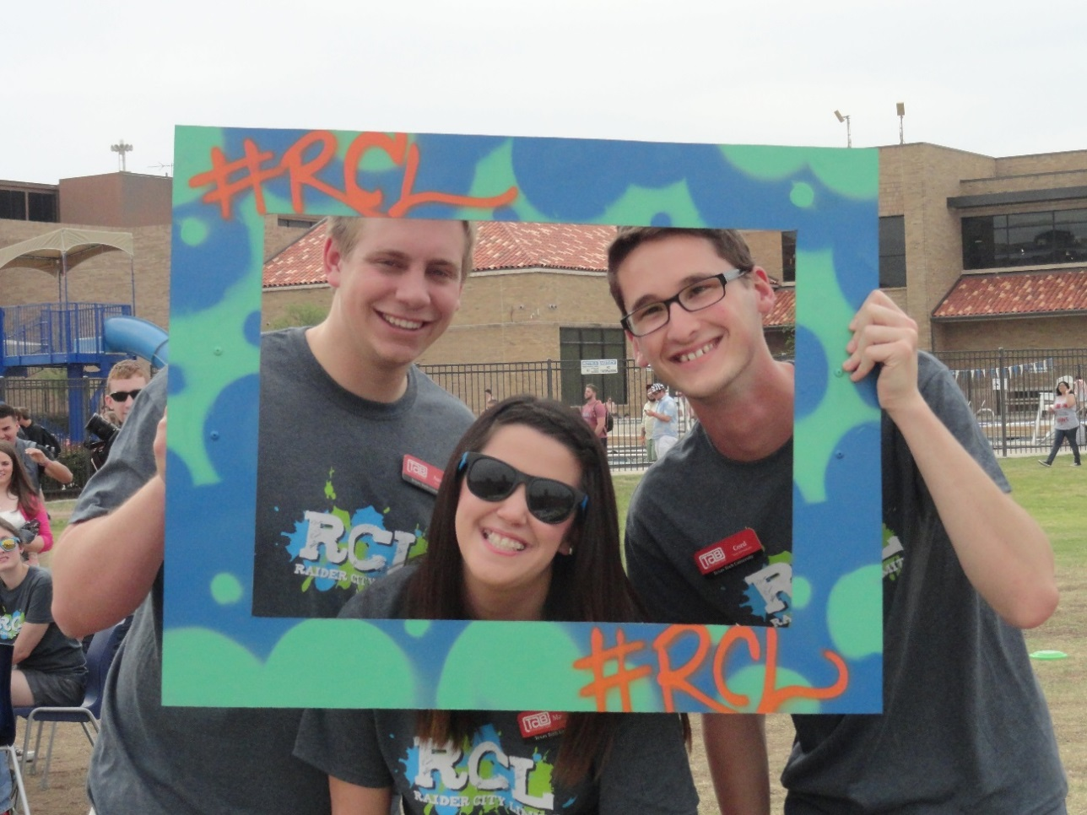
Tech Activities Board (TAB) Publicity
N= 666
After surveying the students, 44% believe that the marketing for TAB events was excellent. Roughly 70% of those surveyed identified that TAB event publicity is above average or better.

Slide 14
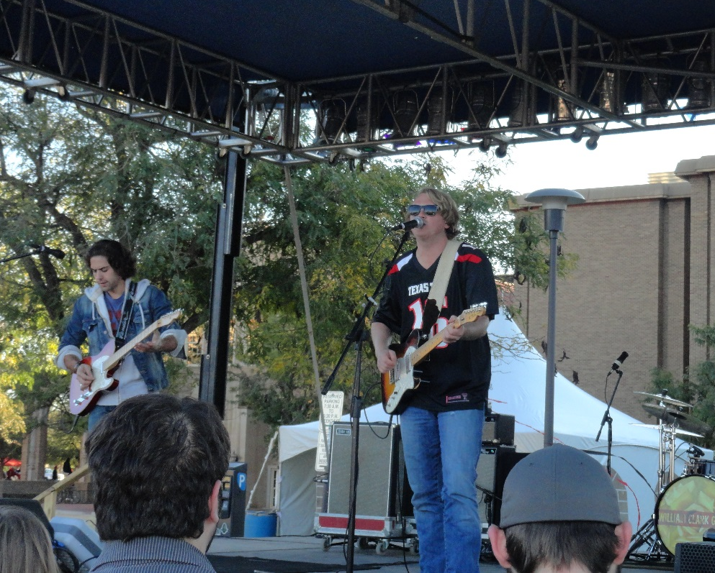
Tech Activities Board (TAB) Venue
N= 666
Students are pleased with the current locations for TAB events, with 85% of the students being satisfied with the locations. TAB events take place in venues throughout the Student Union Building and in a variety of venues across campus.

Slide 15
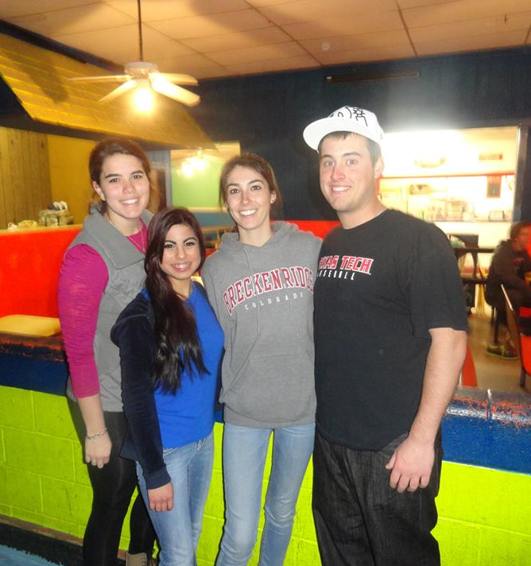
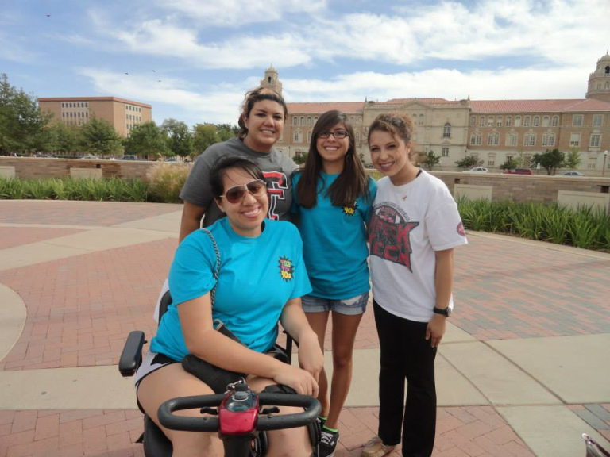
Tech Activities Board (TAB) Time
N= 666
The time for TAB events varies, with times range from daytime to after hours. Students have different schedules and TAB tries to schedule different times during the day.

Slide 16
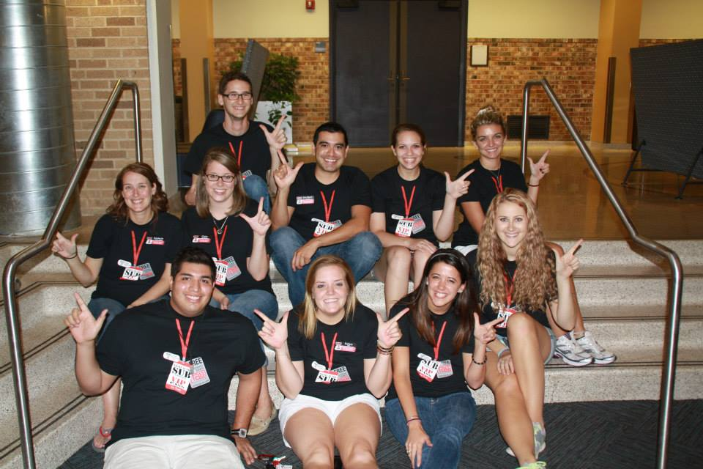
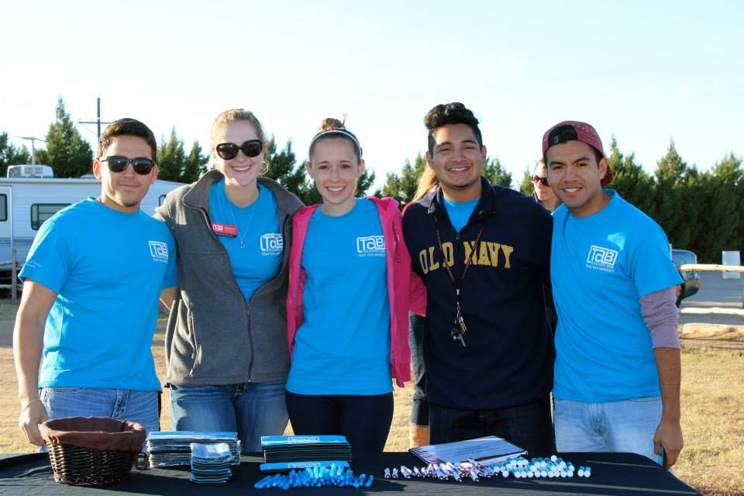
Tech Activities Board (TAB) Day of the Week
N= 666
Of those surveyed, 88% indicated that they were satisfied with TAB event dates. TAB takes this into consideration to encourage more students to attend TAB events.

Slide 17
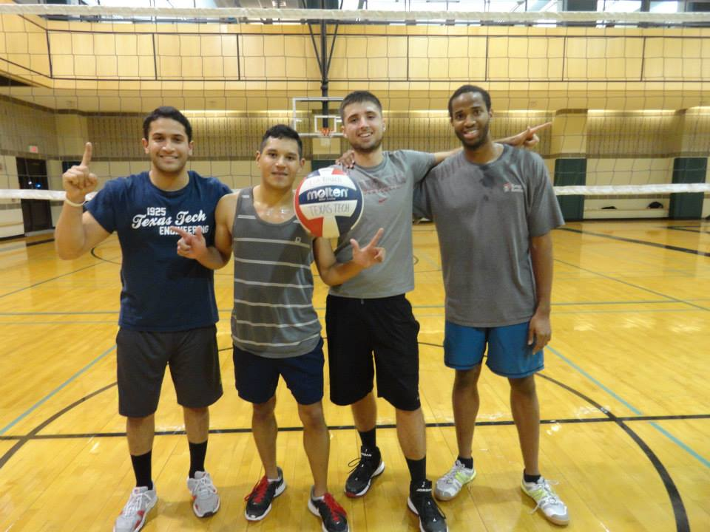
Tech Activities Board (TAB) Quality
N= 666
Of those surveyed, 91% indicated that they viewed the quality of TAB events as above average or excellent.

Slide 18
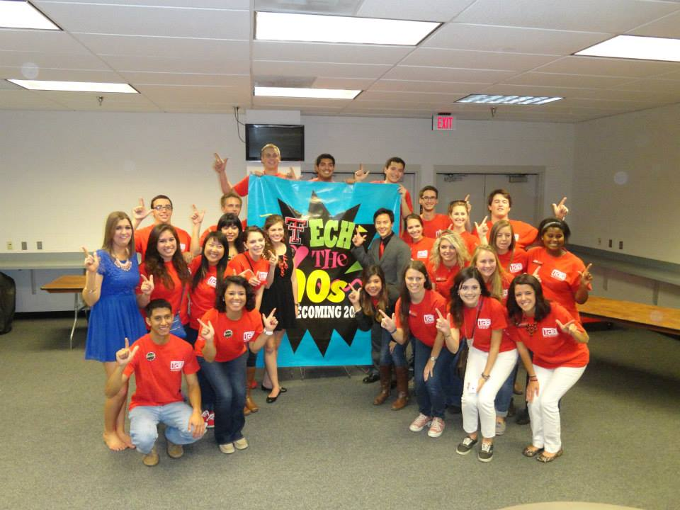
Tech Activities Board (TAB) Overall Satisfaction
N= 666
This is a important statistic from the evaluation. TAB’s goal is to be successful and create great events throughout the year. This year, 65% of individuals surveyed identified their overall satisfaction as excellent.

Slide 19
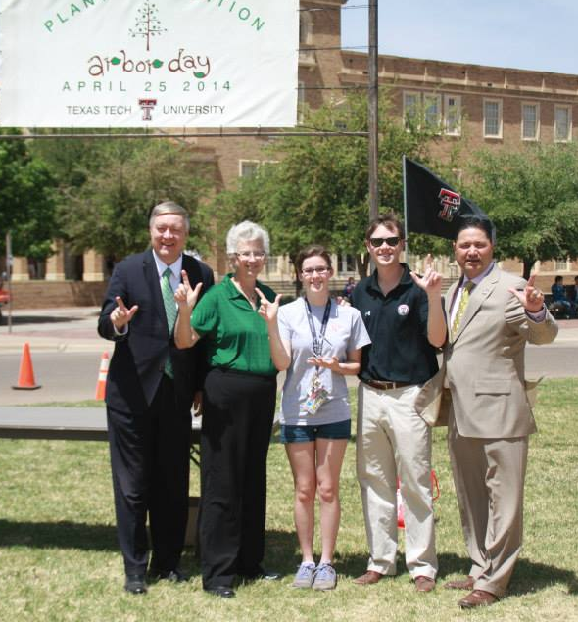
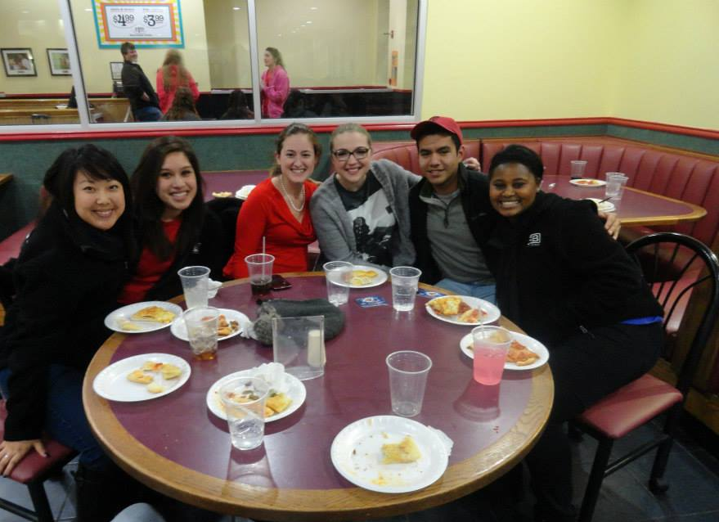
Tech Activities Board (TAB) Faculty Involvement
N= 666
Tech Activities Board evaluated students who were encouraged to attend a TAB event by their professor. TAB encourages faculty involvement by increasing faculty awareness of TAB events related to their curriculum.

Slide 20
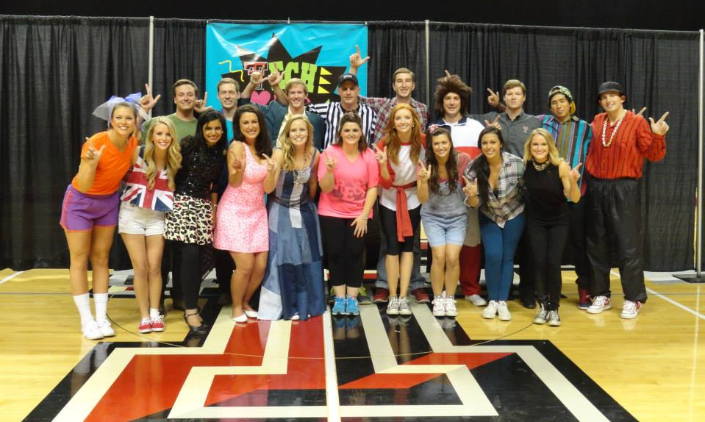
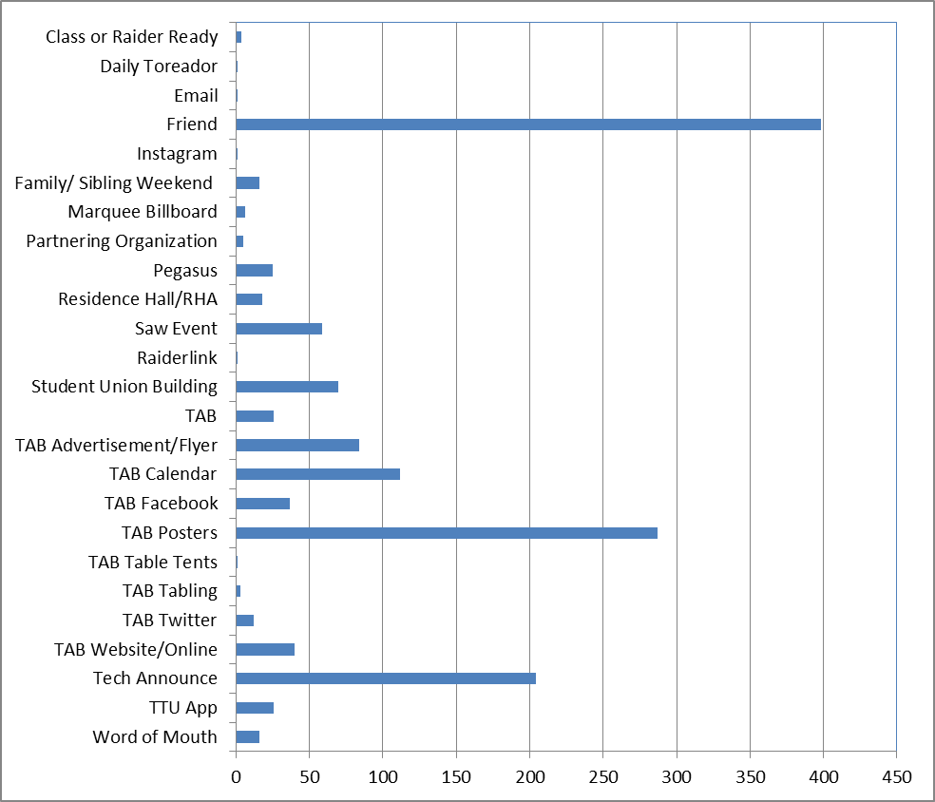
Tech Activities Board (TAB) How did you hear about this event?
The most common answer students give when asked “how did you hear about the event,” was from a friend, this was followed by TAB posters and Tech Announce. This information will help TAB to determine the most effective marketing strategies to increase attendance at events.
*Note: May include multiple responses
N= 666

Slide 21
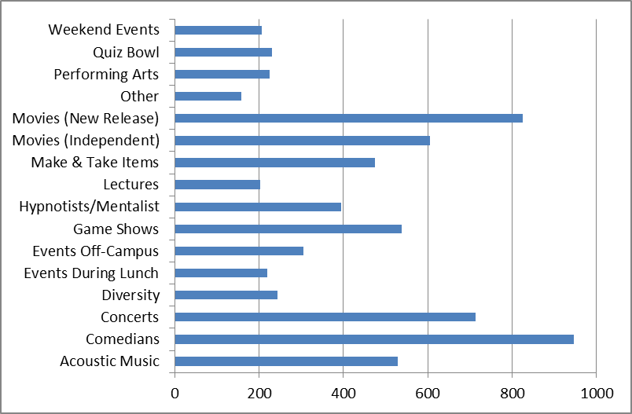
Tech Activities Board (TAB) What events would you like to see in the future?
The most requested events for this year were comedians, movies (new release), and concerts. Independent movies, game shows, and acoustic music were the next highest scoring categories.
N= 666
*Note: May include multiple responses

Slide 22
Tech Activities Board Attendance Numbers
 | 2013-2014
Total Attendance | 26,376
Honorarium Expenses | $144,976.12
Price Per Student | $5.47
Fall Events | 49
Spring Events | 46
Total Number of Events | 95

Slide 23
Tech Activities Board Attendance Per Month
 | Number of Events | Attendance | Honorarium Expenses
August | 8 | 2,109 | $10,435.00
September | 11 | 3,895 | $22,799.00
October | 18 | 11,042 | $49,550.81
November | 10 | 2,123 | $35,649.90
December | 2 | 212 | $1,025.92
January | 9 | 2,317 | $10,654.69
February | 10 | 821 | $6,303.18
March | 10 | 1,144 | $4,418.71
April | 12 | 2,362 | $22,510.28
May | 5 | 351 | $1,887.63
TOTAL | 95 | 26,376 | $144,976.12

Slide 24
Tech Activities Board (TAB)
Event Highlights
Homecoming Week
The theme of Homecoming Week 2013 was “Tech Loves the 90’s!” This year, TAB worked with 50 student organizations and 15 campus departments and community organizations to get involved, 36 royalty candidates competed for Homecoming King and Queen, processed over 200 applications to participate in Homecoming Week programming that included 11 Homecoming Week events hosted by TAB. Almost 9,000 members of the Texas Tech community participated in Homecoming Week 2013!
Arbor Day
TAB collaborated with 5 campus departments to host Arbor Day programming and 121 student organizations and over 2,100 members of the Texas Tech community participated in planting around campus on Arbor Day!
Service Week
TAB collaborated with RHA and the Volunteer Center of Lubbock to host a Service Week programming that included a Volunteer Fair with 8 opportunities for student involvement throughout the week, including writing more than 195 cards for soldiers and 70 blood drive donations!
Notes:
Kickoff – 900
Scavenger Hunt – 30
SO Sing – 4100
RRR – 550
Spin Art Frisbees – 131
Inflatable Twister – 134
Spirit Board – 42
Spirit Banner – 36
Band March –
Pep Rally/Bonfire –
Techsan Memorial –
Techsan Memorial Dinner -

Slide 25
Tech Activities Board (TAB)
Event Highlights
Diversity Week
Diversity Week was a collaboration among TAB and other 14 student organizations and 13 campus departments to host diversity-themed programming comprised of 24 events, including 3 week-long events, attended by over 1,500 Texas Tech students!
National Collegiate Alcohol Awareness Week
TAB partnered with 14 student organizations and campus departments, and 2 community groups, to reach more than 1,500 students through National Collegiate Alcohol Awareness Week programming. These groups hosted 11 events, including an information fair attended by more than 600 students, students made 37 t-shirts displayed for Crossing the Line, and 12 students participated in alcohol screenings throughout the week.
Notes:
Kickoff – 900
Scavenger Hunt – 30
SO Sing – 4100
RRR – 550
Spin Art Frisbees – 131
Inflatable Twister – 134
Spirit Board – 42
Spirit Banner – 36
Band March –
Pep Rally/Bonfire –
Techsan Memorial –
Techsan Memorial Dinner -

Slide 26
Tech Activities Board (TAB)
Event Highlights
Tech or Treat
TAB worked with 3 campus departments and 21 student organizations to host Tech or Treat, Halloween programming that featured 25 interactive booths and activities for kids throughout the Student Union Building. Over 3,100 members of the greater Lubbock community participated in Tech or Treat 2013!
Tech Can Share Food Drive
TAB hosted the Tech Can Share Food Drive throughout November 2013, collecting more than 2,226 lbs. of food to donate to the South Plains Food Bank. Kappa Alpha Theta sorority was recognized among participating student organizations and Student Union & Activities was recognized among participating campus departments as the leading donors this year!
Raider City Limits
TAB and Rec Sports partnered to host the Raider City Limits spring concert. Over 550 students attended the performance by The Crash Kings, enjoyed free food and giveaways, participated in the pool party at the Leisure Pool, played lawn and tailgate games, and took photos in the “selfie” station!
Notes:
Kickoff – 900
Scavenger Hunt – 30
SO Sing – 4100
RRR – 550
Spin Art Frisbees – 131
Inflatable Twister – 134
Spirit Board – 42
Spirit Banner – 36
Band March –
Pep Rally/Bonfire –
Techsan Memorial –
Techsan Memorial Dinner -

Slide 27
Tech Activities Board (TAB)
2013-2014
Student Union & Activities and Tech Activities Board gave away more than 8,200 FREE t-shirts
The @techactivities Twitter account was mentioned 396 times throughout 2013-2014
TAB joined Instagram in 2013, with @ttuTAB posting more than 60 photos and gathering 192 followers and 605 photo likes in our first year
Notes:
Kickoff – 900
Scavenger Hunt – 30
SO Sing – 4100
RRR – 550
Spin Art Frisbees – 131
Inflatable Twister – 134
Spirit Board – 42
Spirit Banner – 36
Band March –
Pep Rally/Bonfire –
Techsan Memorial –
Techsan Memorial Dinner -

Slide 28
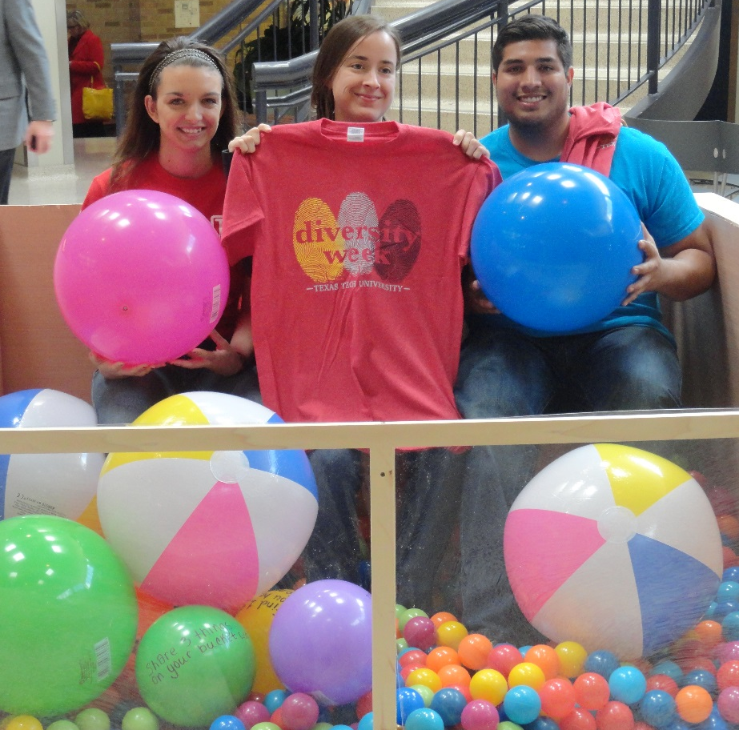
Tech Activities Board (TAB)
Collaborations 2013 - 2014
Fall 2013
Night at the SUB
Indoor Volleyball Tournament
TCU Tailgate
Corn Maize
Tom DeLuca, Hypnotist
Spring 2014
Indoor Volleyball Tournament
Reel Rock Film Festival & Vertical Plains Climbing Competition
Poolapoolooza
Make Your Own Piggy Bank
Drive-In Movie
Raider City Limits
Diversity Week
Arbor Day
Return to Mogadishu
Operation Care Package
Batalla de Puebla: Cinco de Mayo

Slide 29
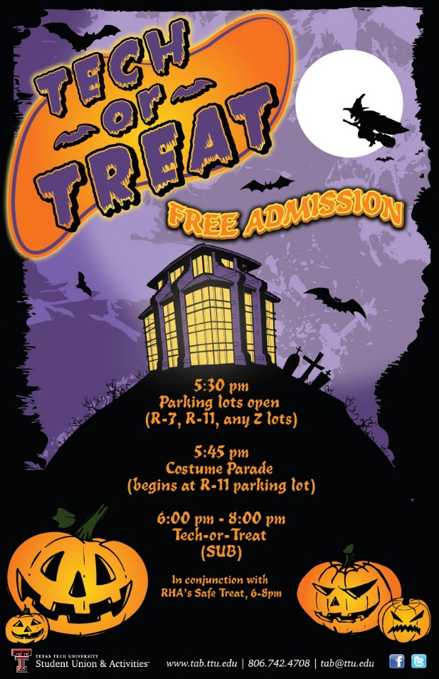
Union Activities
Lubbock Advertising Federation Marketing Awards
BRONZE ADDY Award Winner 2014
Battle of the Bands, logo
GOLD ADDY Award Winner 2014 BRONZE ADDY Award Winner 2014
Tech Can Share Food Drive, poster Tech or Treat, poster

Slide 30
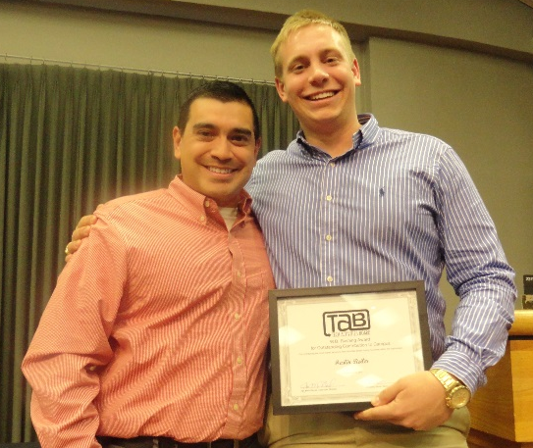
Union Activities
Other Awards
Scholarship
Schubert Family Programming Scholarship recipient, Sam Ravenscroft
I-LEAD Scholarship recipient, Mackenzie Davidson
Tech Activities Board Annual Awards
Jerry V. Fox, Jr. Award for Outstanding Coordinator: McKenzie Hopson
Award for Outstanding New General Member: Madeline Walker
James G. Allen Award for Outstanding General Member: Grant Hollowell
W.B. Rushing Award for Outstanding Contribution to Campus Programs: Austin Reiter
Advisor’s Choice Excellence Award: Zach Powell
TABtime Achievement Award: Rec Sports Department

Slide 31
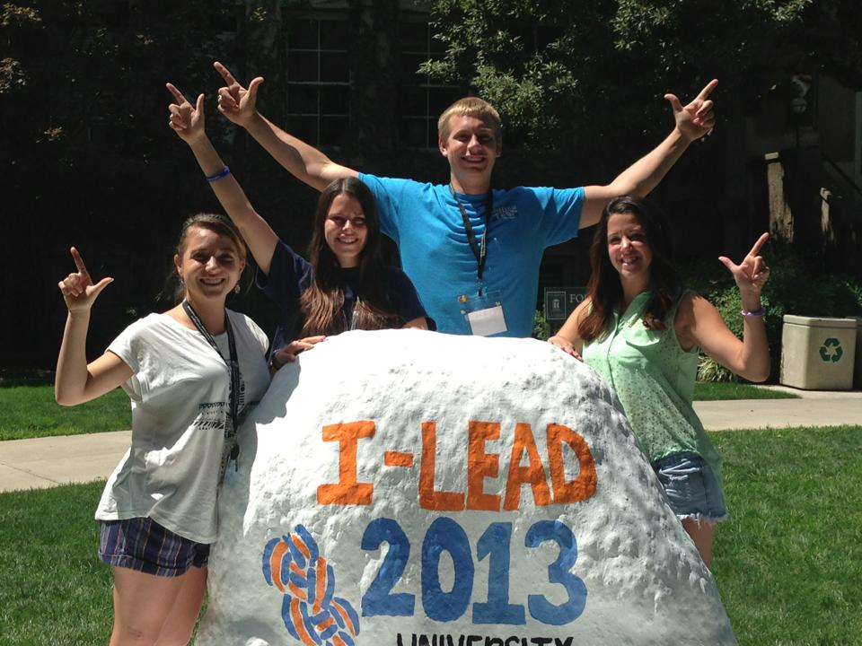
Union Activities
Student Development
Student Development
Graduate Assistants: Kelsey Holt, Skiler Miller
2013 I-LEAD: Natalie Butler, Mackenzie Davidson, Kelsey Koym, Austin Reiter
2013 NSLDC National Conference: Kendall Watson
2013 ACUI Region 12 Conference: Mackenzie Davidson
2014 NACA National Conference: Skiler Miller, AJ Avery, Natalie Butler,
Regine Cliatt, McKenzie Hopson, Kelcy James, Savana Poe
Student Professional Development
2013 ACUI Region 12 Conference educational session presenter: Mackenzie Davidson

Slide 32
Hart Institute for Social Event Planning 2014
Union Activities
Professional Development
New Century Leadership
New Century Leadership is a leadership development and community orientation program for local high school juniors. New Century Leadership is designed to teach Lubbock area youth about the importance of personal and community responsibility.
Emerging Leaders
Emerging Leaders is a year-long annual program offered by the Volunteer Center of Lubbock that helps equip and engage young professionals who are in their 20s or 30s. Through this program participants will learn how to connect with their best volunteer fit, develop skills to enhance high performance teams, serve on a nonprofit board, lead volunteer projects, and find volunteer opportunities.
Conference Attendance
2014 ACUI Annual Conference: Jon Mark Bernal, Claire Maginness
2014 IPDS: New Professionals Orientation, Miranda Russell
2014 American College Health Association Annual Meeting: Kimberly Simon Akins
2014 Hart Institute for Social Event Planning: Kimberly Simon Akins

Slide 33
Tech Activities Board (TAB) Student Leader Learning Outcomes
Student Leader Learning Outcomes Assessment
TAB Leadership and Executive Board members participated in a pre-assessment and post-assessment, self-identifying a variety of learning outcomes along a Likert scale ranging from strongly agree to strongly disagree.
The following six slides reflect the change between pre-assessment and post-assessment data associated with these leadership, decision-making and problem-solving, planning and organization, assessment and evaluation, communication, time and stress management, and financial management learning outcomes, as reported by TAB Executive Board as a collective.

Slide 34
Tech Activities Board (TAB) Student Leader Learning Outcomes
LEADERSHIP
 | Learning Outcome | Year Score
1 | I have the ability to persuade or influence effectively. | -1
2 | I take initiative. | +2
3 | I delegate tasks. | +6
4 | I manage meetings effectively. | +5
5 | I am able to teach various skills. | +2
6 | I motivate others in an organization. | +3
7 | I evaluate skills and knowledge of other individuals. | +2
8 | I confront problems. | +6
9 | I exercise authority when needed. | +1
10 | I work independently. | +3
11 | I foresee problems and take appropriate action. | +1
12 | I am aware of my strengths as a leader. | +5
13 | I am aware of my weaknesses as a leader. | +4
14 | I can effectively recruit, retain and recognize team members. | +5
n=10

Slide 35
Tech Activities Board (TAB) Student Leader Learning Outcomes
DECISION-MAKING AND PROBLEM-SOLVING
 | Learning Outcome | Year Score
15 | I identify issues and their cause/effect. | +4
16 | I mediate in times of dissension. | +4
17 | I reach logical decisions. | +2
18 | I implement decisions. | +5
19 | I deal objectively with situations and people. | +3
20 | I take responsibility for my actions. | 0
21 | I do not procrastinate. | +2
22 | I have an understanding of effecting conflict management. | +5
23 | I believe that my actions reflect sound and ethical decisions. | +3
n=10

Slide 36
Tech Activities Board (TAB) Student Leader Learning Outcomes
PLANNING AND ORGANIZATION
 | Learning Outcome | Year Score
24 | I set goals and specific objectives to meet those goals. | -1
25 | I develop a plan of action to obtain goals and objectives. | +2
26 | I evaluate progress towards the goal upon its completion. | +5
27 | I organize projects into manageable parts and processes. | +1
28 | I set and meet deadlines. | 0
29 | I am knowledgeable of trends in the campus culture | +7
30 | I am aware of the steps involved in event planning. | +9
31 | I know how to organize a major event on campus. | +9
32 | I am knowledgeable of different methods to promote an event. | +8
n=10

Slide 37
Tech Activities Board (TAB) Student Leader Learning Outcomes
ASSESSMENT AND EVALUATION
 | Learning Outcome | Year Score
33 | I know how to use and collect quantitative data for an event. | +5
34 | I know how to use and collect qualitative date for an event. | +5
35 | I know how to evaluate and reflect on an event. | +4
36 | I know how to benchmark with other programming boards and universities. | +7
n=10

Slide 38
Tech Activities Board (TAB) Student Leader Learning Outcomes
COMMUNICATION
 | Learning Outcome | Year Score
37 | I give clear instructions | +3
38 | I listen empathetically. | +4
39 | I have a command of written English. | +2
40 | I have a command of verbal English. | +5
41 | I have a command of e-mail and text messaging. | +5
42 | I can give constructive feedback. | +2
43 | I can accept feedback in an appropriate manner. | +4
44 | I feel confident speaking in front of large groups. | +8
45 | I am comfortable interviewing for campus leader positions. | +4
46 | I seek out my advisor for advice about my programming position. | +3
47 | I seek out my advisor for advice about academics and/or my personal life. | +2
n=10

Slide 39
Tech Activities Board (TAB) Student Leader Learning Outcomes
TIME AND STRESS MANAGMENT
 | Learning Outcome | Year Score
48 | I work effectively under pressure. | +4
49 | I exhibit effective means of coping with stress. | +4
50 | I effectively manage my time. | +4
51 | I make immediate logical decisions. | +4
52 | I create a balance between academic, employment, and co-curricular activities. | +3
FINANCIAL MANAGEMENT
 | Learning Outcome | Year Score
53 | I can read and analyze a budget. | +3
54 | I accept financial responsibility and work within a budget. | +3
n=10

Slide 40
Tech Activities Board (TAB) Student Leader Learning Outcomes
ADAPTABILITY
 | Learning Outcome | Year Score
55 | I can read and analyze a budget. | +4
56 | I accept financial responsibility and work within a budget. | +3
57 | I react well to change. | +4
HUMAN RELATIONS
 | Learning Outcome | Year Score
58 | I demonstrate a cooperative spirit. | +2
59 | I try to understand the varying backgrounds and lifestyles of others. | +2
60 | I respond to the needs of my peers/colleagues. | +2
61 | I actively educate myself in different cultures. | +6
62 | I cultivate relationships with others different from myself. | +4
n=10

Slide 41
Contributors
Jon Mark Bernal, Associate Director Kristin Miller, Senior Business Assistant
Kimberly Simon-Akins, Assistant Director Rhonda Bratcher, Specialist III
Autumn Arthur, Unit Manager Kelsey Holt, Graduate Assistant
Claire Maginness, Unit Coordinator Skiler Miller, Graduate Assistant
Miranda Russell, Unit Coordinator
Data compiled by Kelsey Holt & Skiler Miller
Graduate Assistants for Student Union & Activities

