Slide 1
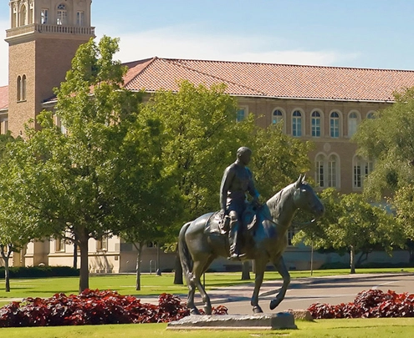
Retirement
Texas Tech University Human Resources

Slide 2
Texas Tech University Retirement Plans
Participation in retirement is a condition of employment for full & part-time benefits-eligible faculty & staff.
By default, all employees will be enrolled in the Teacher Retirement System (TRS) upon hire and contributions will begin on the first paycheck via payroll deduction.
Select positions are eligible to enroll in the Optional Retirement Program (ORP) in lieu of TRS. Eligible employees are notified via email by our office and will have 90 days from appointment into ORP-eligible position to make their retirement election.
Refer to “Retirement Plans” on TTU HR Website

Slide 3
Teacher Retirement System of Texas
This is a defined benefit plan
Employees contribute 8.25%* of their monthly salary, pre-tax
TTU also contributes 8.25%* to the account on your behalf
Monthly retirement benefit is “defined” by a formula; not based off member contributions
Must meet age and service retirement criteria to receive annuity
Disability retirement
Survivor benefits
*contributions are subject to Legislative change
Refer to “Retirement Plans” on TTU HR Website

Slide 4
TRS Retirement Eligibility
At age 65 with minimum 5 years of TRS Membership, OR
The Rule of 80 where Age + Years of TRS Membership = 80 or greater
Detailed information regarding eligibility can be found by locating your “tier”
Register for MyTRS after 60 days of employment at www.trs.texas.gov
Refer to “Retirement Plans” on TTU HR Website

Slide 5
Optional Retirement Program (ORP)
This is a defined contribution plan
Currently, employees contribute 6.65%* of their monthly salary, pre-tax
TTU contributes 6.8%* to your account on your behalf
Retirement income based on contributions and performance of investments
Vested after 1 year & 1 day of participation
Investments are selected and controlled by employee
Deadline to enroll is 90 days from appointment into ORP-eligible position and is a one-time, irrevocable decision
*contributions are subject to Legislative change
Refer to “Retirement Plans” on TTU HR Website

Slide 6
Retirement Plan Election
ORP-eligible employees will receive email notification from TTU Human Resources. You will have 90 days from the first day in the ORP-eligible position to make the decision to enroll. If you do not return your completed forms to TTU Human Resources by the deadline, you will remain in TRS.
By default, you will be enrolled in TRS and will make TRS contributions. Your TRS contributions can be refunded or rolled over into another eligible retirement account (not ORP) and you will forfeit the contributions TTU made on your behalf.
Refer to “Retirement Plans” on TTU HR Website

Slide 7
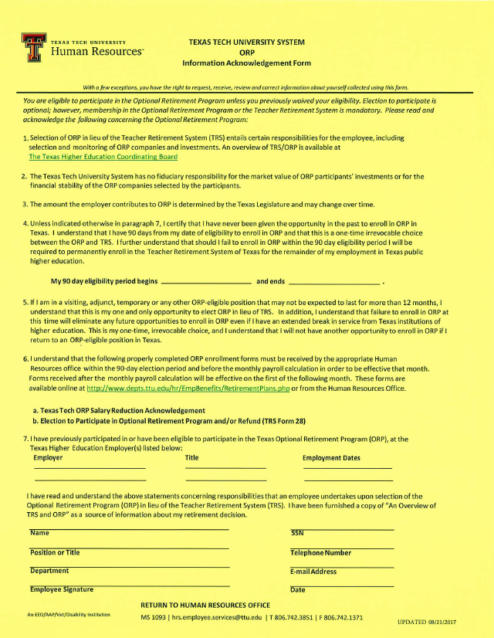
ORP Acknowledgement Form
Required from ANYONE who is offered ORP
Please review Section 7 carefully
Complete the personal information at the bottom of the page, sign, date, & return to the Employee Services Center at hr.esc@ttu.edu

Slide 8
Supplemental Retirement Programs
Did you know…
Your retirement plan should include personal savings & investments, in addition to your pension plan and your Social Security benefits. Contributions made to a supplemental retirement program now, can grow without taxes for a longer time. The sooner you start saving, the more you may have when you retire, which can help bridge the gap between employer plans and other benefits like Social Security.
While an employee of Texas Tech University, you have the option to participate in one, or two, supplemental retirement programs, in addition to the mandatory retirement plan.
Social Security
Pension (State retirement)
Personal Savings & Investments

Slide 9
Supplemental Retirement Programs
Tax Deferred 403(b) Account
Allows you to set aside money for retirement, either pre-tax or after-tax, via payroll deduction
Contribution limits are set by the IRS
An account can be opened through Retirement Manager at www.myretirementmanager.com
Select your vendor and the amount to be deducted each paycheck
Annual contribution limit for 2024:
$23,000 (plus $7,500 if you are 50 or over)
Note: The state will not make contributions to this account on your behalf
Refer to “Retirement Plans” on TTU HR Website

Slide 10
Supplemental Retirement Programs
Texa$aver 457 Plan
Allows you to set aside money for retirement, either pre-tax or after-tax, via payroll deduction
Contribution limits are set by the IRS
An account can be opened by calling Texa$aver at 800.634.5091 or at www.texasaver.com
Contributions can be modified at any time during the year
Annual contribution limit for 2024:
$23,000 (plus $7,500 if you are 50 or over)
Note: The state will not make contributions to this account on your behalf
Refer to “Retirement Plans” on TTU HR Website

