Slide 1
A Guide to Academic Integrity for Faculty and Instructors
The Office of Student Conduct

Slide 2
The Office of Student Conduct
A Guide to Academic Integrity for Faculty and Instructors
JaWana Green, Managing Director
Mairead Kiernan, Associate Director
Academic Integrity Hearing Officer
Phone: (806) 742-1714
Mail Stop: 5029

Slide 3
The Code of Student Conduct

Slide 4
The Code of Student Conduct
A Guide to Academic Integrity for Faculty and Instructors
Academic Dishonesty
Cheating
Plagiarism
Collusion
Misrepresenting Facts
Violation of Professional Standards
Unfair Academic Advantage

Slide 5
A Guide to Academic Integrity for Faculty and Instructors
Guidelines for Addressing Allegations

Slide 6
Guidelines for Addressing Allegations
A Guide to Academic Integrity for Faculty and Instructors
Review of Allegations
Meet with the Student(s)
Complete an Incident Report Form
Formal Academic Integrity Hearing

Slide 7
Step 1: Review of Allegations
A Guide to Academic Integrity for Faculty and Instructors
Notify Instructor of Record
Follow departmental procedures for notification of Department Chair, Associate Dean, etc.
Contact the Office of Student Conduct, if needed, to develop a plan to proceed
(806) 742-1714
Collect any evidence related to the incident
Examples: cheat sheet, doctor’s note, syllabus, turnitin.com report, copy of test or assignment

Slide 8
Step 2: Inform the Student(s)
A Guide to Academic Integrity for Faculty and Instructors
At the minimum, the student(s) should be notified via email
Initiate a meeting with each involved student
Describe the allegation and share evidence
Give the student the opportunity to respond to allegations
Do you still feel that a violation occurred?
If yes…
Explain that a report will be filed with the Office of Student Conduct who will conduct an investigation and hearing
Refer student to OSC for questions regarding the Conduct process
Explore likely academic outcomes with the student, if found responsible
Notify the student that they may NOT withdraw from the course during the investigation

Slide 9
Step 3: Complete the Incident Report
A Guide to Academic Integrity for Faculty and Instructors
Follow departmental procedures for notifying Associate Academic Dean and/or Department Chair
Incident Report Form
Office of Student Conduct Website, MS 5029, via e-mail to a Conduct Officer
Detailed account of the incident
Any available evidence
Office of Student Conduct Investigation Begins
Independent and fact-gathering

Slide 10
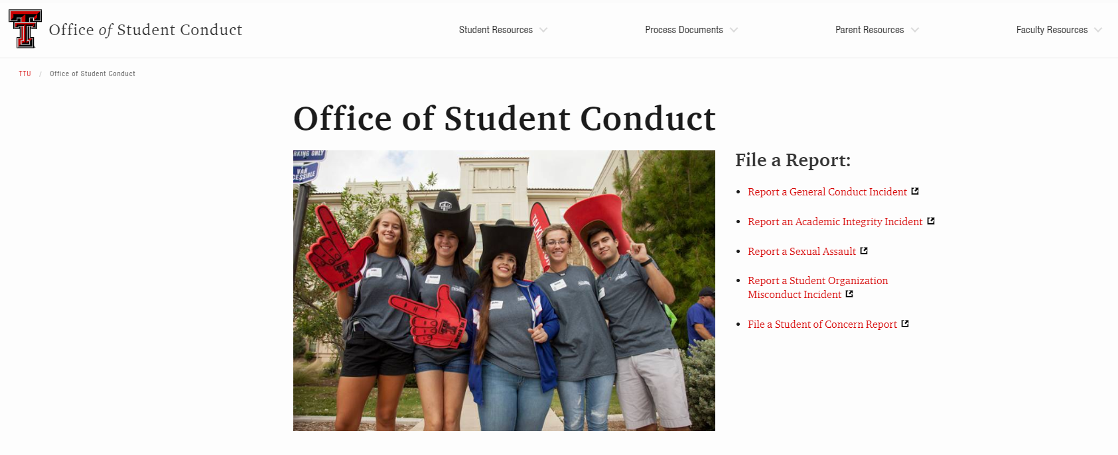
A Guide to Academic Integrity for Faculty and Instructors
https://cm.maxient.com/reportingform.php?TexasTechUniv&layout_id=12

Slide 11
Step 4: Formal Academic Integrity Hearing
A Guide to Academic Integrity for Faculty and Instructors
Student will receive a letter with scheduled meeting date and time with the Office of Student Conduct
Administrative or Panel Hearing
Responsible or not responsible finding determined
Disciplinary sanctions are delivered by conduct officer, if found responsible
Academic Penalty
In the event of a responsible finding, the Office of Student Conduct will put in place the academic penalty suggested by the faculty

Slide 12
Possible Academic Penalties
A Guide to Academic Integrity for Faculty and Instructors
Failing grade for the course or assignment
Relevant make-up assignment(s)
No credit for the assignment
Make-up assignment different that the original assignment
Alternative make-up examination
Reduction in grade for the assignment/course
NOTE: If the faculty member must submit a final grade in the course before an Academic Integrity investigation is complete, notify the Department Chair and/or Associate Academic Dean of the investigation and leave the grade blank.

Slide 13
A Guide to Academic Integrity for Faculty and Instructors
Tips for Addressing and Preventing Academic Misconduct

Slide 14
While Administering an Exam
A Guide to Academic Integrity for Faculty and Instructors
Allow the student to complete exam
Relocate student
Confiscate cell phone/ unauthorized material/devices for duration of exam
Collect all materials that the student used to complete the exam
Be respectful and discreet if you must approach a student during an exam
Do not make a scene during or after the exam

Slide 15
Meeting with the Student(s)
A Guide to Academic Integrity for Faculty and Instructors
Meet with involved students separately
Ask students not to discuss the incident with any other students
Do not identify other students involved
Refrain from using accusatory language/making assumptions
Allow students to review the evidence, but do not give them a copy

Slide 16
A Guide to Academic Integrity for Faculty and Instructors
The Syllabus
Be clear about your policies and cover them more than once
Exams, Quizzes, Attendance, Homework, Papers, Projects
When are students permitted to work together?
What are the limitations?
What style guide should a student use for written assignments?
Reference the Student Handbook and Code of Student Conduct and give the web address
Require a “syllabus quiz” and/ or a signed Academic Integrity agreement
Inform students that allegations of Academic Dishonesty will be referred to the Office of Student Conduct
If you choose to put “hard and fast” rules in your syllabus about academic penalties for academic dishonesty, be prepared to enforce them

Slide 17
A Guide to Academic Integrity for Faculty and Instructors
Exams
Check TTU Identification Cards
Try not to use the textbook’s provided test banks
Students have discovered ways to access these “instructor-only” resources
Develop multiple exams
Mix up the question order, change constant numbers, print on different colored paper
Provide and/or control ALL materials that a student has access to
Distribute and collect all scratch paper and formula sheets
Limit use of multiple choice questions
It’s much much harder to copy someone’s essay
Change the essay questions for classes that meet and test on different days
Essay questions are easily remembered and passed on to those who have not yet tested

Slide 18
A Guide to Academic Integrity for Faculty and Instructors
Projects and Homework
Be very clear about collaboration and group work
If you choose to allow group work, consider allowing the group to submit the assignment as a group
Allow group members to assess their fellow group mates
If group work of any kind will not be tolerated, explain exactly how strict this policy is
– Can they talk about the assignment, share online resources, etc.?
Be upfront about plagiarism detection software
Explain to students what you’re using, what it detects, and how it works

Slide 19
A Guide to Academic Integrity for Faculty and Instructors
Papers and other Written Assignments
Be clear about the writing expectations
Offer resources to teach students about the writing process
Require the use of a style guide in ALL written work done outside of class
Allow students to choose which style guide they prefer, if the course material allows
Require that students purchase the style guide as a part of their course materials, if the course is “writing heavy”
You aren’t doing your students any favors by not requiring the use of a style guide
Make paper topics very specific and/or require students to develop their own topics in class
Develop “check points” throughout the paper writing process
Keep copies of drafts and compare it to the final product
Require an annotated bibliography
Consider requiring oral presentations of written assignments

