Slide 1



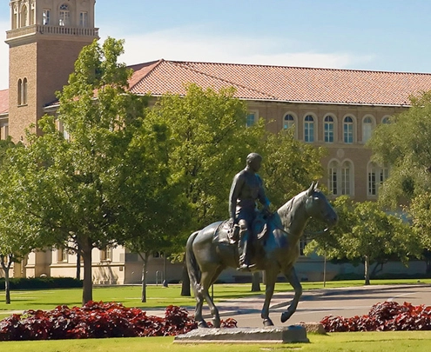


Welcome to Benefits Orientation
Texas Tech University Human Resources

Slide 2
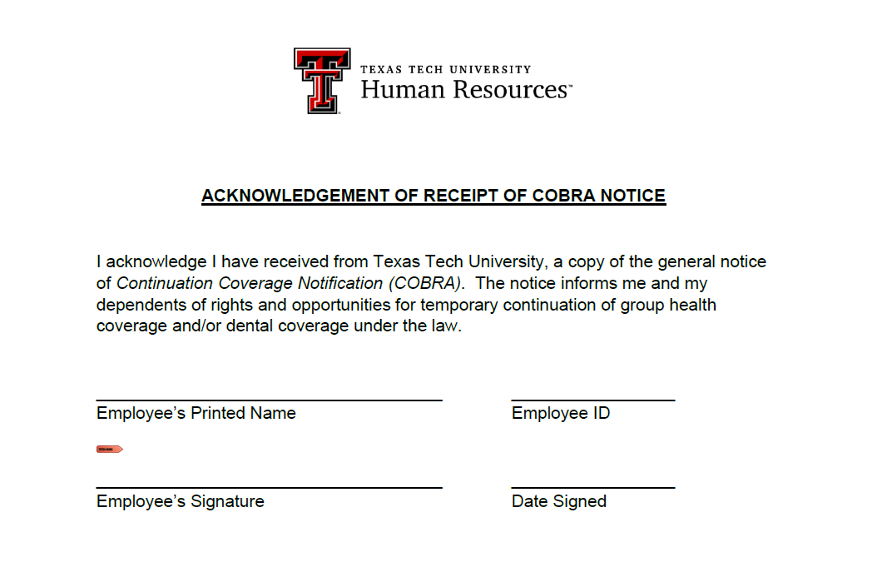
COBRA Acknowledgement
COBRA Acknowledgement Form can be found on the HR Website at https://www.depts.ttu.edu/hr/EmpBenefits/NewEmpIns.php
Please return your signed COBRA Acknowledgement to hr.esc@ttu.edu

Slide 3

New Employee Benefits
As a TTU employee, health benefits are offered through the Texas Group Benefits Program (GPB) administered by the Employees Retirement System of Texas (ERS)
More information regarding health benefits and enrollment, including an electronic copy of the New Employee Benefits Guide, can be accessed via the TTU HR Webpage at https://www.depts.ttu.edu/hr/EmpBenefits/NewEmpIns.php
Contact information for all agencies can be found on page 43 of the NEBG

Slide 4
Enrollment Deadlines
Benefit Option | When to Enroll | Coverage Begins
Health and Prescription TexFlex – Health Care FSA | Within 60 days of hire | 1st of the month following 60 days of hire Hire date: 9.01.2025 Coverage begin date: 11.01.2025
Optional Coverages Ex: Vision, Dental, Life, etc. | Within 31 days of hire | 1st of the month following election Election made: 9.19.2025 Coverage begin date: 10.01.2025
**Please note: certain circumstances may allow you to waive the waiting period.
If one of the scenarios listed on page 22 apply to you,
please reach out to the Employee Services Center as soon as possible at hr.esc@ttu.edu
See page 7 of New Employee Benefits Guide

Slide 5
Enrollment Opportunities
Aside from your Initial Eligibility Period (first 31 days of hire), there are TWO other opportunities for you to enroll in, or make changes to your health benefits:
Experiencing a Qualifying Life Event
Examples include:
Marriage
Birth of a child
Loss of coverage
You have 31 days from the date of your QLE to make changes to your benefits
See pages 5 of New Employee Benefits Guide

Slide 6
Enrollment Opportunities
Aside from your Initial Eligibility Period (first 31 days of hire), there are TWO other opportunities for you to enroll in, or make changes to your health benefits:
2. Summer Enrollment
A period of time each summer during which ERS allows all employees to make changes to their health benefits without a QLE
All changes made during this time go into effect on September 1st
See page 5 of New Employee Benefits Guide

Slide 7
Eligible Dependents
You may elect benefits for your eligible dependents, including:
Spouse
Biological Child
Stepchild
Adopted child
*For health insurance, children must be under age 26, and can be married or unmarried.
**For dental coverage, children must be under age 26 and unmarried.
See pages 5-6 of New Employee Benefits Guide

Slide 8

Certification & Verification of Dependents
Enrolling dependents in medical coverage is a two-part process:
Certification is done through the online enrollment process via the ERS website or via paper form.
Verification is done by Alight Solutions. A letter will be mailed to the address you provided on your W-4. It will outline the steps in the verification process, as well as the timeframe and documentation that is required.
Please note: if your dependent(s) are found to be ineligible, ERS will remove them from coverage.
See pages 5-6 of New Employee Benefits Guide

Slide 9

Health Plan Options
 | HealthSelect of Texas | Consumer Directed HealthSelect
 | Point of Service Plan | High Deductible Plan with HSA
Key Advantages | Lower OOP costs for in-network care Copays for certain in-network services, like primary care (PCP) office visits Large statewide network, and large nationwide network for those who live and/or work outside Texas | Tax-advantaged health savings account (HSA), with monthly contributions from the state Large statewide & nationwide networks Referrals not required Lower month premium than HealthSelect of Texas for dependents & part-time employees
Key Disadvantages | Referrals needed for most specialty care Monthly premiums for dependents and part-time employees are higher than Consumer Directed HealthSelect | Except for specific preventive services and a few limited items, the plan pays nothing until the deductible is met Must meet IRS’ eligibility guidelines to participate in the HSA
See pages 9-11 of New Employee Benefits Guide or visit www.healthselectoftexas.com

Slide 10
HealthSelect of Texas
Benefit | In Network | Out of Network
Annual Deductible | None | $500 individual $1,500 family
Coinsurance Max | $2,000 | $7,000
PCP Required | Yes | No
PCP Copay | $25 | 40% - after deductible
Specialist Copay | $40 | 40% - after deductible
Urgent Care | $50 copay + 20% coinsurance | 40% - after deductible
Annual Eye Exam | $40 | 40% - after deductible
See pages 16-19 of New Employee Benefits Guide or visit www.healthselectoftexas.com

Slide 11
Designating a Primary Care Physician
The HealthSelect of Texas medical plan requires the designation of a Primary Care Physician. Your PCP is responsible for coordinating your care, and making a referral to a specialist, if needed.
You have 60 days from your date of hire to select a PCP. After 60 days, if a PCP has not been chosen, out-of-network benefits will apply for any services rendered.
This form is also used to notify BlueCross BlueShield if you will have other medical coverage in addition to your HealthSelect coverage (once effective), or if your dependents reside at a different address than you (Section E).

Slide 12
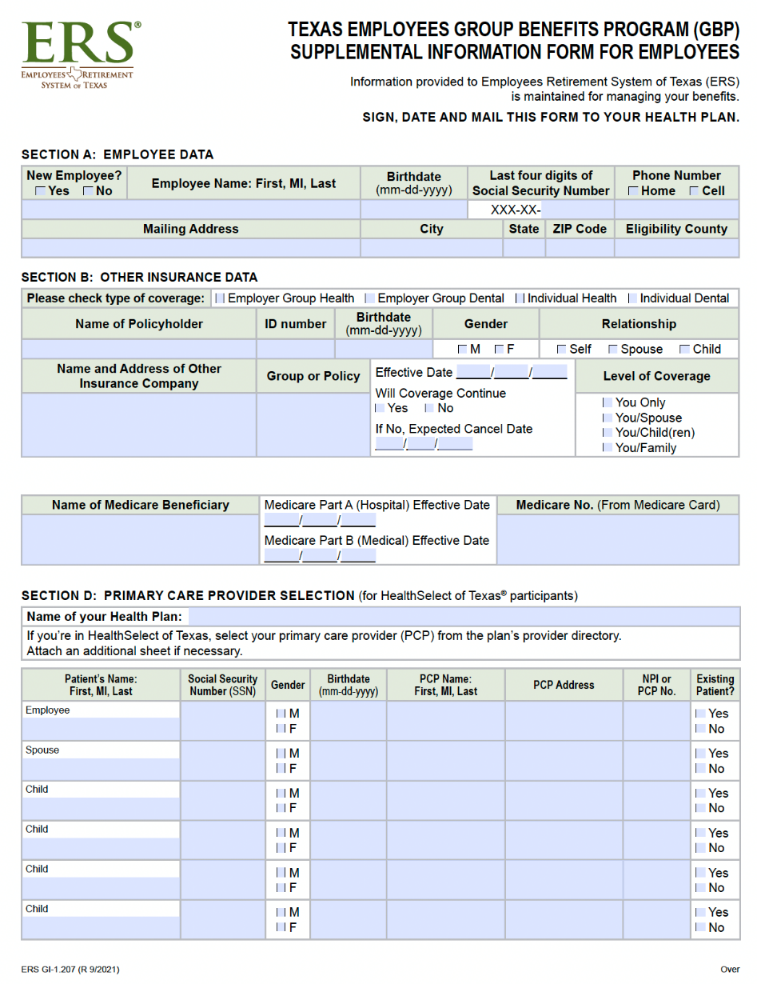
Designating a Primary Care Physician
To select a PCP, please complete the PCP Supplemental Information Form for Employees and mail to the HealthSelect address on the bottom, left-hand corner of the form.
This form can be found on the TTU HR website under Employee Benefits -> New and Newly Benefits Eligible ->Your First 60 Days
For a list of physicians in the HealthSelect network, please visit www.healthselectoftexas.com
Click Find Doctor or Hospital

Slide 13

TexFlex Health Care FSA
Allows you to set aside money pre-tax from your paycheck to cover eligible out-of-pocket health care expenses
Available only to HealthSelect of Texas participants
 | Health Care FSA
Annual Contribution (Plan Year September 1 to August 31) | Minimum: $180 Maximum: $3,300
Eligible Expenses | Medical, dental, vision, and prescription drug expenses, including copays and coinsurance
Debit Card | Yes
Rollover | Up to $660
Submit Claims | Submit all claims by December 31st for expenses incurred between September 1 and August 31
See Pages 30-31 of New Employee Benefits Guide

Slide 14
Consumer Directed HealthSelect
High Deductible Health Plan
Benefit | In Network | Out of Network
Annual Deductible | $2,100 individual $4,200 family | $4,200 individual $8,400 family
Coinsurance | Plan pays – 80% Participant pays – 20% Preventive services – 100% | Plan pays – 60% Participant pays – 40% Preventive services – 40%
Out of Pocket Max | $8,050 individual $16,100 family | None
Please note: Deductible includes prescription expenses
See pages 16-19 of New Employee Benefits Guide or visit www.healthselectoftexas.com

Slide 15

Health Savings Account (HSA)
Participants who choose to enroll in the Consumer Directed HealthSelect plan must set-up a Health Savings Account
The money in your HSA is owned by you and is yours to take, even if you leave employment or retire. The funds rollover from year to year.
Annual Contribution | Individual | Family
State | $540 | $1,080
Employee | $3,610 | $7,220
IRS Maximum | $4,300 | $8,550
Additional $1,000 per year catch up for individual age 55 and older.
See pages 12-13 of New Employee Benefits Guide

Slide 16

Prescription Benefits
 | HealthSelect of Texas | Consumer Directed HealthSelect
Deductible | $50 per participant | $2,100 individual $4,200 family
Copay: In-network | Up to a 30-day supply of Non-maintenance medications: Tier 1: $10 Tier 2: $35 Tier 3: $60 Maintenance medications: Tier 1: $10 Tier 2: $45 Tier 3: $75 | 20% coinsurance after the annual deductible is met
Extended Days Supply In-Network | 90-day Supply: Tier 1: $30 Tier 2: $105 Tier 3: $180 | 20% coinsurance after the annual deductible is met
Copay: Out-of-network | Copay PLUS 40% coinsurance for all tiers | 40% coinsurance after the annual deductible is met
Mail Order | Yes | Yes
Brand-name Drug Penalty | If a generic drug is available and you choose the brand-name drug, you will pay the Tier 1 copay or coinsurance, as applicable, PLUS the difference in cost to the plan between the brand-name drug and the generic drug.
See page 20 of New Employee Benefits Guide

Slide 17
Full-Time Medical Premiums
 | Premium | State Pays | You Pay
HealthSelect of Texas
You Only | $ 674.62 | $ 674.62 | $ 0.00
You + Spouse | 1,447.90 | 1,061.26 | 386.64
You + Children | 1,192.38 | 933.50 | 258.88
You + Family | 1,965.66 | 1,320.14 | 645.52
Consumer Directed HealthSelect (HDHP)
You Only | $ 674.62 | 674.62 | $ 0.00
You + Spouse | 1,409.22 | 1,061.26 | 347.96
You + Children | 1,166.50 | 933.50 | 233.00
You + Family | 1,901.10 | 1,320.14 | 580.96
See page 34 of the New Employee Benefits Guide

Slide 18

Virtual Visits
Virtual Visit providers may also send an e-prescription to your pharmacy if necessary
PCP referrals are not required, but you must use a network virtual provider
With Medical Virtual Visits, you have 24/7 access to Board Certified physicians via phone, secure video, or mobile app for a variety of non-emergency conditions such as cold/flu, ear infections, pink eye, nausea and more
No cost if enrolled in HealthSelect of Texas or HealthSelect of Texas Out-of-State
Consumer Directed HealthSelect participants are subject to deductible and coinsurance
Visit www.healthselectoftexas.com

Slide 19
Tobacco Certification
You MUST certify your status – whether you use tobacco or not!
Anyone enrolled in health insurance (including dependents of all ages) MUST certify tobacco status as a user or non-user. Users, and those who fail to certify, pay a monthly tobacco user premium.
*Tobacco products include, but are not limited to, cigarettes, cigars, pipe tobacco, chewing tobacco, snuff, dip, and all electronic cigarettes and vaping products.
ERS offers the Choose to Quit program to help employees and/or their dependents quit tobacco.
See page 15 of New Employee Benefits Guide

Slide 20
Insurance Opt-Out Credit
Available to employees who choose to waive the health insurance offered to them by ERS because they have other health insurance coverage that is equal to, or better than, the GBP
The benefit:
Up to $60 per month for Full-time employees
Up to $30 per month for Part-time employees
There is no cash value. You can use the credit to apply towards your monthly dental, vision, and/or Voluntary Accidental Death & Dismemberment premiums
Consider carefully: If you opt-out of the GPB coverage, you forfeit the prescription drug coverage, as well as the $5,000 Basic Term Life and AD&D coverage
See page 13 of New Employee Benefits Guide

Slide 21
Requesting New Medical & Prescription ID Cards
For Medical ID Card
Call BlueCross BlueShield at 800.252.8039
Provide Group # 238000 or SSN
Or access a digital copy by downloading the BCBSTX Mobile App
For Prescription ID Card
Call Express Scripts at 855.828.9834
Provide Group # ERSOFTX or SSN
Or access a digital copy by downloading the Express Scripts app
**The doctor’s office or pharmacy can also verify coverage with the appropriate Group # or SSN

Slide 22

Dental Insurance
 | DeltaCare USA DHMO | State of Texas Dental Choice Plan PPO
Can I go to any dentist? | You must designate a Primary Care Dentist | In-network/participating dentist | Out-of-network/non-participating dentist
Deductible? | No | Preventive: Individual - $0; Family - $0 Combined Basic/Major: Individual - $50; Family - $150 Orthodontic services: no deductible | Preventive: Individual - $50; Family - $150 Combined Basic/Major: Individual - $100; Family - $300 Orthodontic services: no deductible
Copays or coinsurance? | Copays vary according to service | Preventive & Diagnostic: no charge Basic service: 10% coinsurance after meeting deductible Major services: 50% coinsurance after meeting deductible | Preventive & Diagnostic: 10% coinsurance after meeting deductible Basic service: 30% coinsurance after meeting deductible Major services: 60% coinsurance after meeting deductible
Maximum calendar year benefit | Unlimited | $2,000 per covered individual (includes orthodontic extractions) | $2,000 per covered individual (includes orthodontic extractions)
www.ersdentalplans.com
See pages 24-25 of New Employee Benefits Guide

Slide 23
Dental Premiums
 | DeltaCare DHMO | State of Texas Dental Choice Plan
You Only | $ 9.59 | $ 28.73
You + Spouse | 19.18 | 57.46
You + Child(ren) | 23.02 | 68.95
You + Family | 32.59 | 97.68
www.ersdentalplans.com
See page 35 of New Employee Benefits Guide

Slide 24

Vision Insurance
State of Texas Vision | State of Texas Vision
 | In-Network | Out-of-Network
Routine eye exam | $15 copay | Up to $40 after $15 copay
Frames or contact lenses | $200 retail allowance | Up to $75 or up to $150 retail
Standard contact lens fitting | $25 copay | Up to $100 retail
Single vision lenses | $10 copay | Up to $30 retail
Bifocal lenses | $15 copay | Up to $45 retail
www.stateoftexasvision.com
See page 26 of New Employee Benefits Guide

Slide 25

Evidence of Insurability (EOI)
Some benefit elections, such as life insurance or disability insurance, require proof of good health.
EOI is an application process through which you provide information on the condition of your health or your dependent’s health in order to be considered for certain types of insurance coverage
You will indicate if you prefer to receive your EOI application by mail or email
  Submitting your completed EOI application online is quicker and more efficient
The underwriter will review your application. ERS will then update your benefit information accordingly
** Please note: EOI is not required for elections made during your Initial Eligibility Period
(first 31 days of hire)
See Page 27 of New Employee Benefits Guide

Slide 26
Optional Term Life Insurance
This life insurance coverage provides you with additional financial protection to help secure the future for those who depend on you
Optional Term Life
(employee only)
1 X your annual salary
2 X your annual salary
3 X your annual salary*
4 X your annual salary*
*Evidence of Insurability always required
Dependent Term Life
Provides insurance benefits if your dependents are injured or die as a result of an accident
  $5,000 term life
  + $5,000 AD&D
$1.45 covers all eligible dependents named under the coverage
See page 27 of New Employee Benefits Guide

Slide 27
Voluntary AD&D Insurance
Can provide additional financial support in the event of an accidental injury or death
Benefit:
Can elect coverage for yourself only, or for yourself and your eligible dependents
Minimum coverage: $10,000
Maximum coverage: $200,000
Coverage amounts made in increments of $5,000
Cost:
You Only: $0.02 per $1,000 of coverage
You + Family: $0.04 per $1,000 of coverage
See page 28 of New Employee Benefits Guide

Slide 28

Texas Income Protection Plan
Protects your income by paying a percentage of your paycheck if you become disabled and can’t work due to a medical illness, injury, or pregnancy
Short-term disability insurance provides a portion of your monthly income for up to 5 months
Benefit:
Maximum of 66% of your monthly salary (up to $10,000) or $6,600, whichever is less
Eligibility:
Must provide physician certification stating you are totally disabled and unable to work
Must complete a waiting period of 14 consecutive days and
Must exhaust all sick leave (including sick leave pool)
Long-term disability provides a portion of your monthly income for an extended period of time
Benefit:
Maximum of 60% of your monthly salary (up to $10,000) or $6,000, whichever is less
Eligibility:
Must provide physician certification stating you are totally disabled and unable to work
Must complete a waiting period of 180 consecutive days and
Must exhaust all sick leave (including sick leave pool)
See pages 28-29 of New Employee Benefits Guide

Slide 29

TexFlex Dependent Care Account
Allows you to set aside money pre-tax from your paycheck to cover eligible dependent care expenses
 | Dependent Care FSA
Annual Contribution (Plan Year September 1 to August 31) | Minimum: $180 Maximum: $5,000 per household
Eligible Expenses | Day care, before and after school care, and summer day camp for dependent children under age 13*
Debit Card | No
Rollover | No
Submit Claims | Submit all claims by December 31st for expenses incurred between September 1 and August 31
* Adult custodial care programs for qualifying dependents
See pages 30-31 of New Employee Benefits Guide

Slide 30

Teacher Retirement System of Texas
Participation is mandatory for all Full-time & Part-time employees, and begins on the first day of employment
This is a defined benefit plan
Currently, employees contribute 8.25%* of their monthly salary, pre-tax
  TTU also contributes 8.25%* to your account on your behalf
Monthly retirement benefit is “defined” by a formula; not based off member contributions
Must meet age and service retirement criteria to receive annuity
Disability retirement
Survivor benefits
*contributions are subject to Legislative change
Refer to “Retirement Plans” on TTU HR Website

Slide 31
TRS Retirement Eligibility
At age 65 with minimum 5 years of TRS Membership, OR
When you meet the Rule of 80 where Age + Years of TRS Membership = 80 or greater
Detailed information regarding eligibility can be found by locating your “tier”
Register for MyTRS after 60 days of employment at www.trs.texas.gov
Refer to “Retirement Plans” on TTU HR Website

Slide 32
Optional Retirement Program (ORP)
This is a defined contribution plan
Currently, employees contribute 6.65%* of their monthly salary, pre-tax
  TTU contributes 6.8%* to your account on your behalf
Retirement income based on contributions and performance of investments
Vested after 1 year & 1 day of participation
Investments are selected and controlled by employee
Deadline to enroll is 90 days from hire date and is a one-time, irrevocable decision
*contributions are subject to Legislative change
Refer to “Retirement Plans” on TTU HR Website

Slide 33
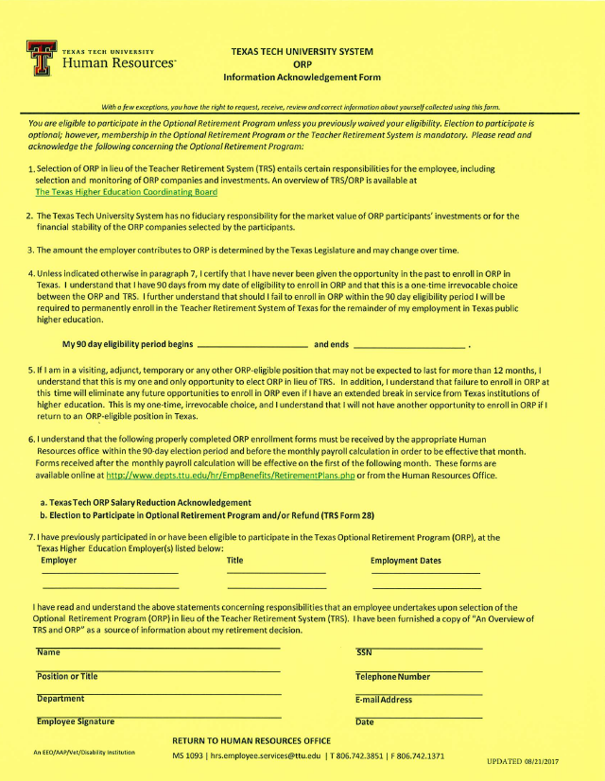
ORP Acknowledgement Form
Required from ANYONE who is offered ORP
Please review Section 7 carefully
Complete the personal information at the bottom of the page, sign, date, & return to HR.

Slide 34
Supplemental Retirement Programs
Did you know…
Your retirement plan should include personal savings & investments, in addition to your pension plan and your Social Security benefits. Contributions made to a supplemental retirement program now, can grow without taxes for a longer period of time. The sooner you start saving, the more you may have when you retire, which can help bridge the gap between employer plans and other benefits like Social Security.
While an employee of Texas Tech University, you have the option to participate in one, or two, supplemental retirement programs, in addition to the mandatory retirement plan.
Social Security
Pension (State retirement)
Personal Savings & Investments

Slide 35

Supplemental Retirement Programs
Tax Deferred 403(b) Account
Allows you to set aside money for retirement, either pre-tax or after-tax, via payroll deduction
Contribution limits are set by the IRS
An account can be opened through Retirement Manager at www.myretirementmanager.com
Select your vendor and the amount to be deducted each paycheck
Annual contribution limit for 2025:
$23,500 (plus $7,500 if you are 50 or over)
Note: The state will not make contributions to this account on your behalf
Refer to “Retirement Plans” on TTU HR Website

Slide 36

Supplemental Retirement Programs
Texa$aver 457 Plan
Allows you to set aside money for retirement, either pre-tax or after-tax, via payroll deduction
Contribution limits are set by the IRS
An account can be opened by calling Texa$aver at 800.634.5091 or at www.texasaver.com
Contributions can be modified at any time during the year
Annual contribution limit for 2025:
$23,500 (plus $7,500 if you are 50 or over)
Note: The state will not make contributions to this account on your behalf
Refer to “Retirement Plans” on TTU HR Website

Slide 37

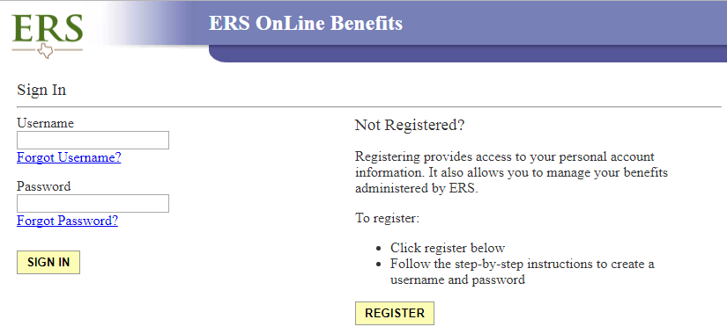
Benefits Enrollment
Enrollment is done using the ERS OnLine Portal at www.ers.texas.gov
Create an account by clicking on the My Account Login button on the top right of the page, and then Register Now
ERS uses 3 pieces of information to identify you while setting up your new account:
Social Security Number
Date of Birth
Address
If you are unable to create an account, please send an email to hr.esc@ttu.edu

Slide 38
Benefits Enrollment
The ERS OnLine Portal is unavailable to new hires from June 14th to August 31st
To make your post-hire elections, please complete the following forms and return to hr.esc@ttu.edu
Benefit Election Form
Dependent Child Certification Form (if applicable, one form per child)
TexFlex Enrollment Form (if applicable)
To ensure timely processing of your elections, please return your completed forms prior to your 29th day of hire. Our office cannot process forms during the weekend or on day 30/31 of hire. Employees who wait until day 30/31 will have to contact ERS at 877.275.4377 and make elections via phone. ERS does not keep weekend hours.

Slide 39
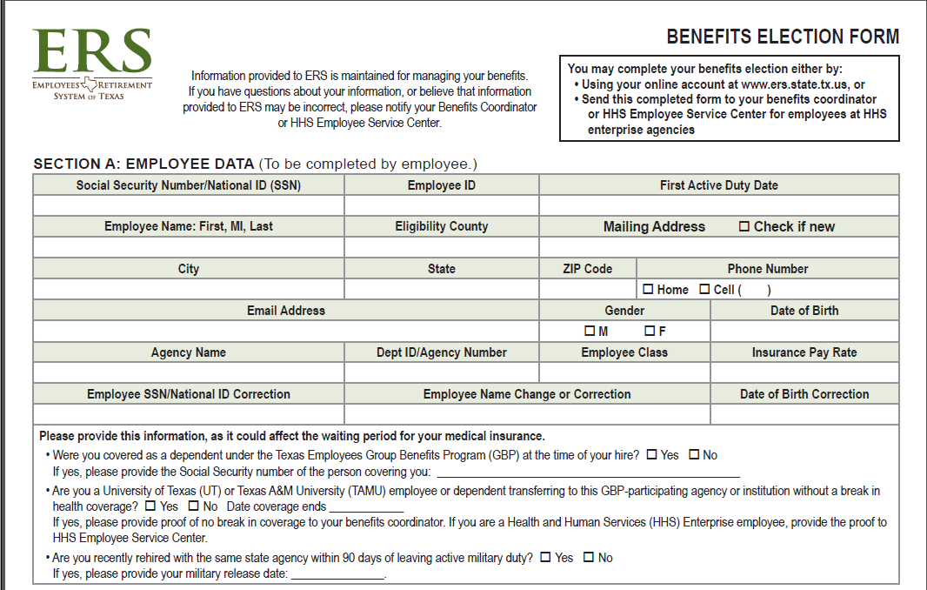
Benefits Enrollment
Elections will be done using a Benefit Election Form
This can be found on the HR website at https://www.depts.ttu.edu/hr/EmpBenefits/NewEmpIns.php under the Enrollment tab
You will also need to complete
One Dependent Child Certification Form, per child, if applicable
TexFlex Enrollment Form, if applicable
Forms should be returned to hr.esc@ttu.edu for processing

Slide 40
Benefits Enrollment
Please note: The address you provided on your W4 during onboarding is the address that was entered into ERS. By default, your ELIGIBILITY COUNTY that is provided to ERS is LUBBOCK
This address/county will be considered your coverage area and is where you will have “in-network” benefits
Should you relocate at any time during your employment, please:
Submit a new W4 to the Employee Services Center at hr.esc@ttu.edu
Update your address and county with ERS by calling them at 877.275.4377

Slide 41
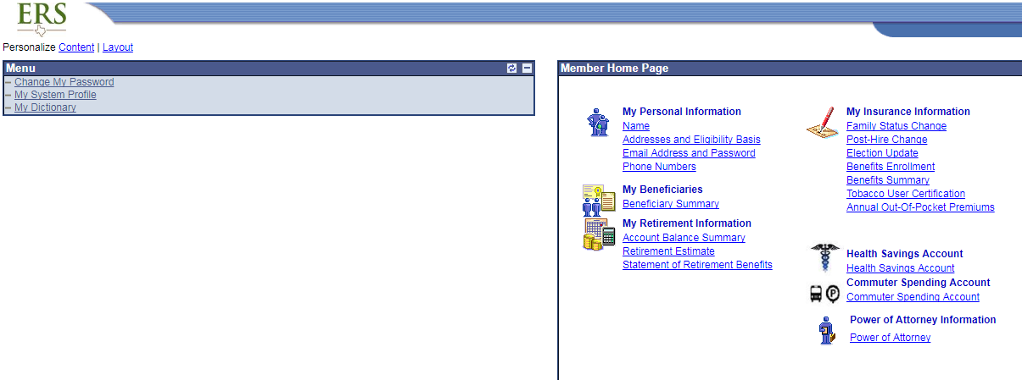
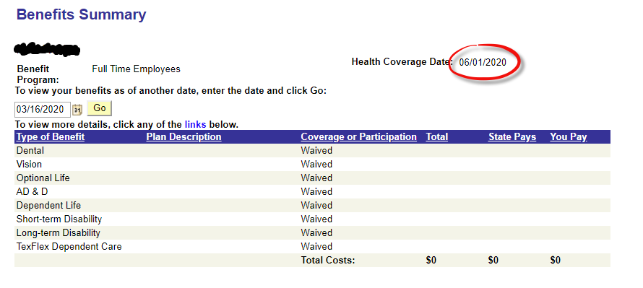
ERS OnLine System
All new hires will use the Post-Hire Change link to make elections
After you submit your elections, you’ll need to change the calendar on the Benefits Summary to the 1st of the following month to see optional coverages, or to the Health Coverage Date to see all coverages elected
Post-Hire Change
**Please note: if you are directly transferring from another institution of higher education in Texas, you will need to notify a Benefits Coordinator via email at hr.esc@ttu.edu prior to making your elections

Slide 42
Benefits Recap
Within 31 days of your hire date, you should enroll yourself and eligible dependents in:
Dental Insurance
Vision Insurance
Optional Term Life Insurance (for yourself)
Voluntary Accidental Death & Dismemberment
Dependent Term Life Insurance
Texas Income Protection Plan (for yourself
  Short & Long-Term Disability
TexFlex Dependent Care Flexible Spending Account

Slide 43
Benefits Recap
All Full-time employees are automatically enrolled in HealthSelect of Texas for medical coverage
Within 60 days of your hire date, you should:
Decide to remain in the HealthSelect of Texas medical plan, switch to the Consumer Directed HealthSelect medical plan, or opt-out of health coverage
  Be sure to watch the mail and complete the Dependent Verification Audit sent by Alight Solutions, if enrolling dependents (in the same health coverage you are enrolled in)
Certify tobacco-user status for yourself and any covered dependents
Enroll in TexFlex HealthCare Flexible Spending Account (available only to those enrolled in the HealthSelect of Texas plan)
Contact OptumBank to open a Health Savings Account (available only to those enrolled in the Consumer Directed HealthSelect plan)

Slide 44

Employee Services Center
Doak Conference Center – Corner of 15th & University
Phone: 806.742.3851 Fax: 806.742.1371
Email: hr.esc@ttu.edu
Employees Retirement System of Texas (ERS)
Phone: 877.275.4377
Website: www.ers.texas.gov
Teacher Retirement System (TRS)
Phone: 800.223.8778
Website: www.trs.texas.gov

