Slide 5
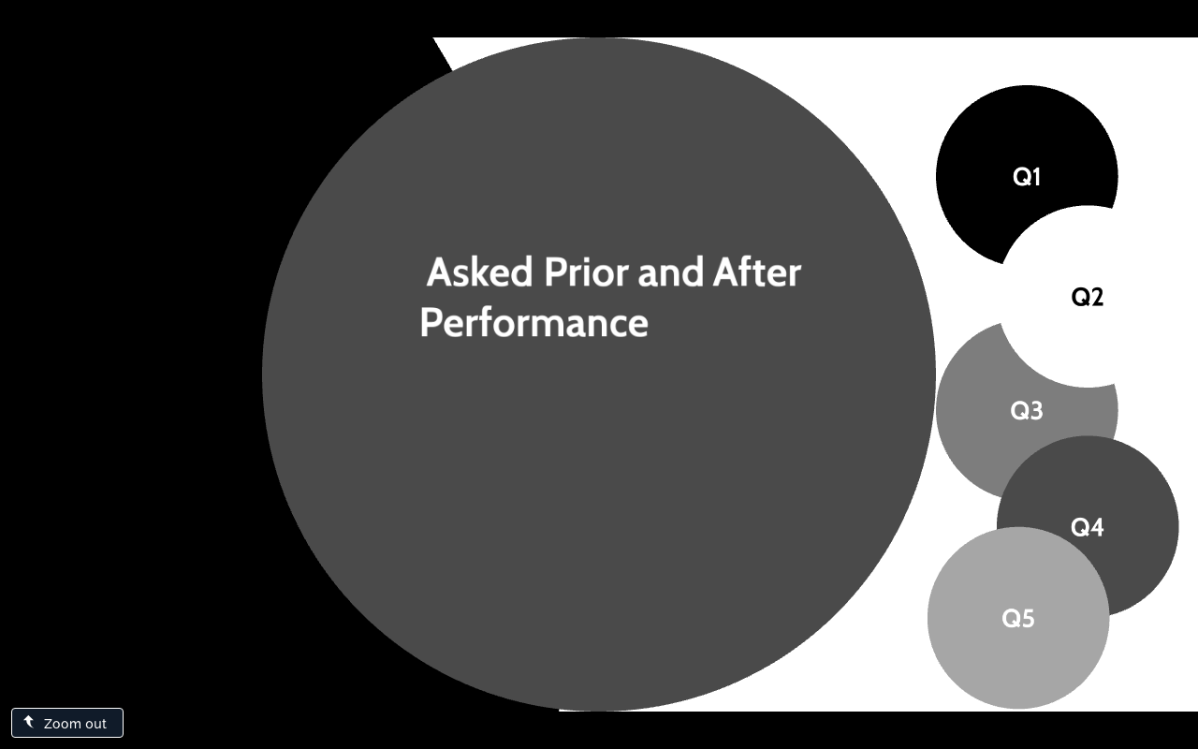
Fre-Test
Asking the audience to “Predict” where we will need to improve, what do you think will stand out

Slide 11
https://www.youtube.com/watch?v=5nPbIOF4Mc4&t=80s

Slide 14
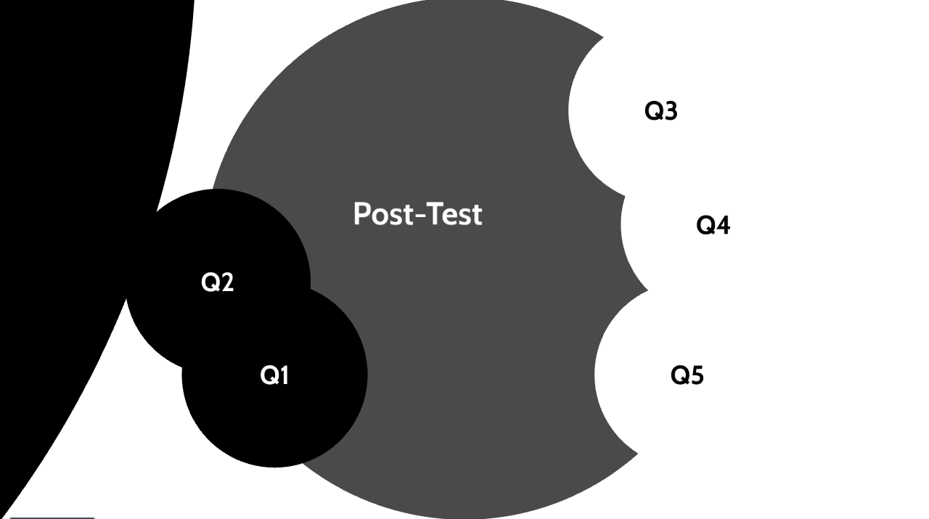

Slide 17
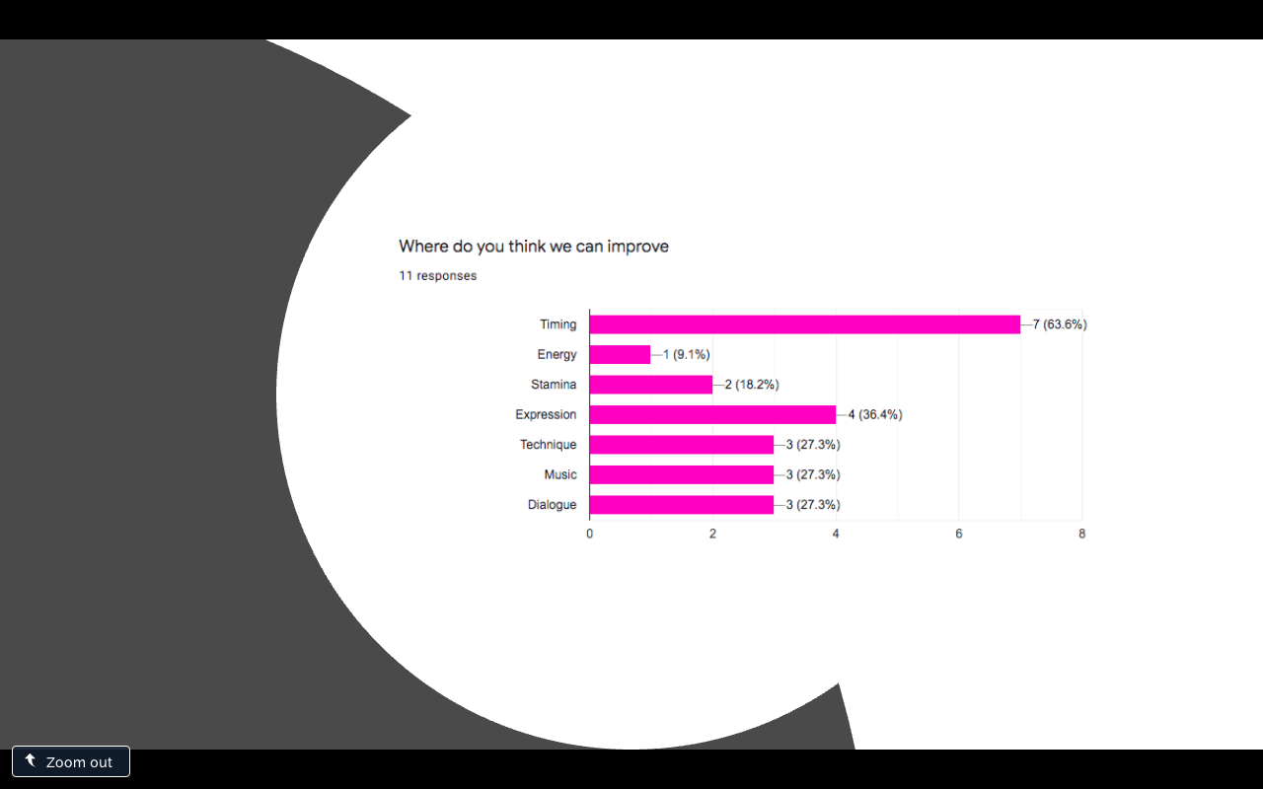

Slide 18
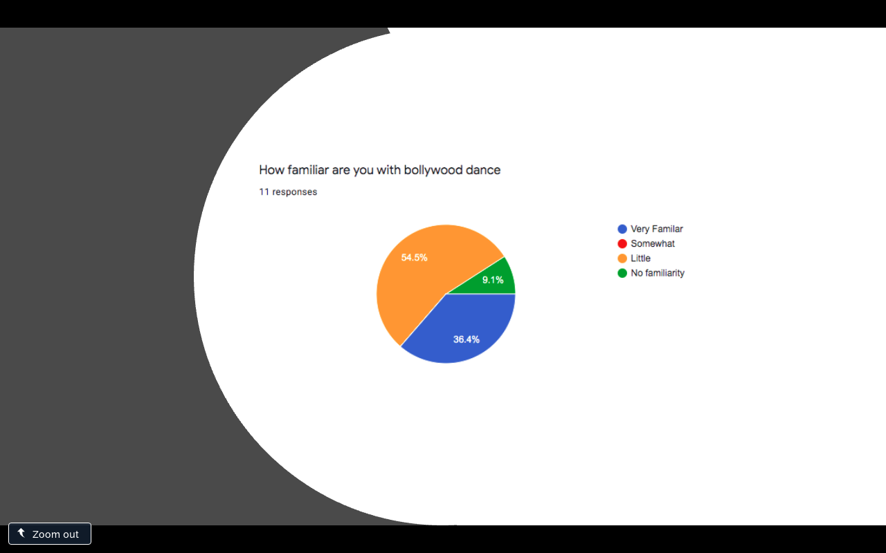

Slide 19
