Slide 1

Insert Title or Logo

Slide 2


TEXAS TECH SNAPSHOT
• More than 35,000 students currently enrolled
• TTU is comprised of 13 Colleges:
Agriculture
Architecture
Arts & Sciences
Business Administration
Education
Engineering
Honors
Human Sciences
Mass Communications
Visual &Performing Arts
University College
School of Law
Graduate School

Slide 3
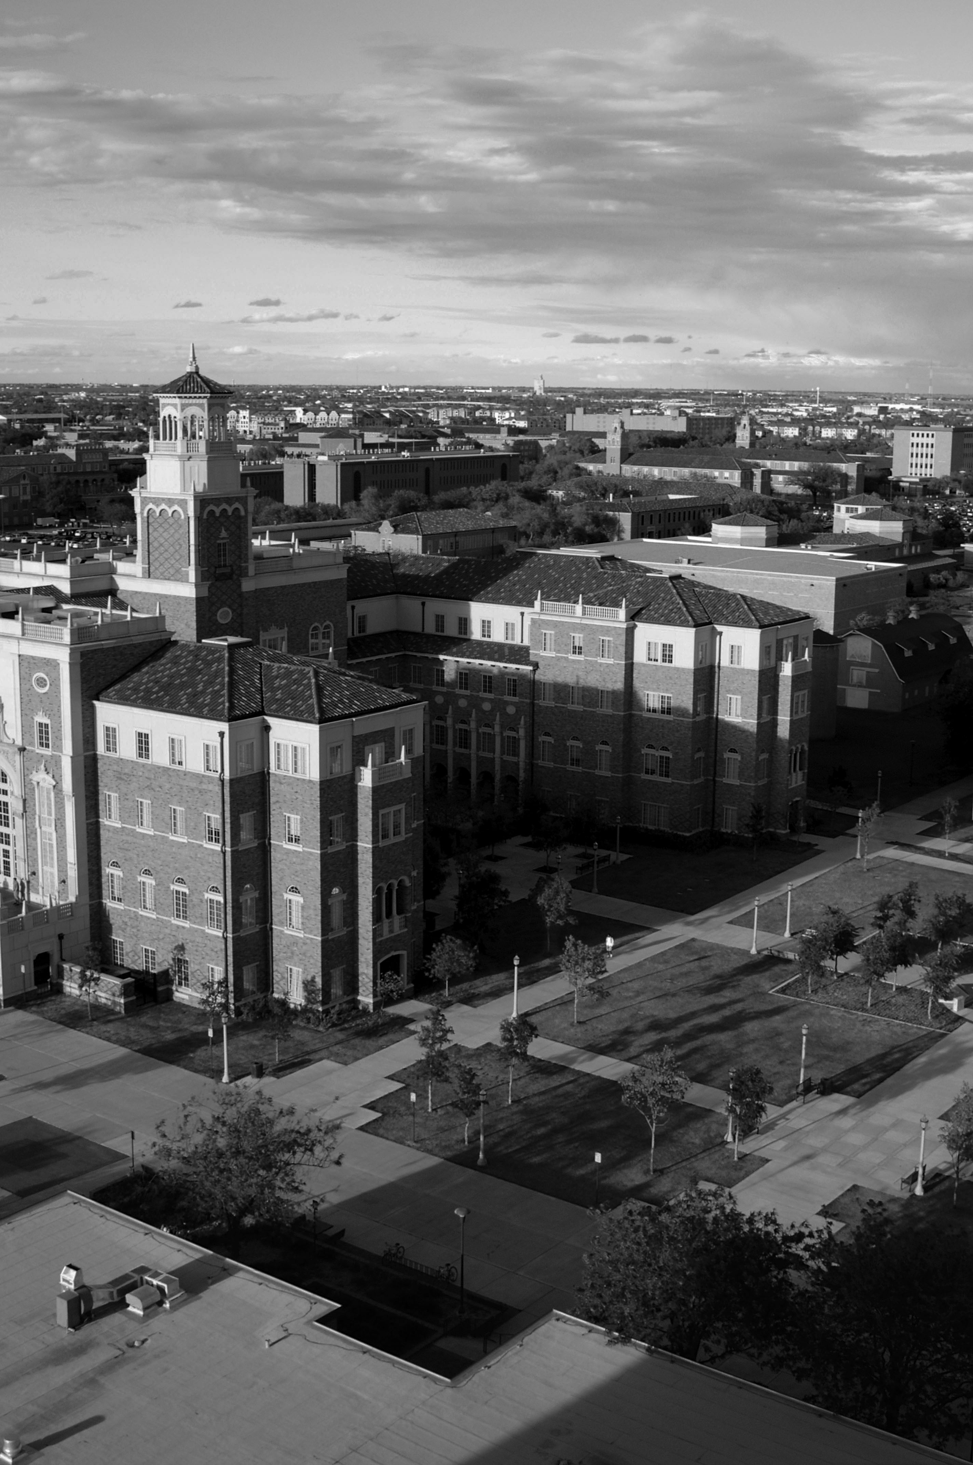
TEXAS TECH SNAPSHOT
• Bullet Point 1
• Bullet Point 2
• Bullet Point 3
• Bullet Point 4
• Bullet Point 5

Slide 4
A QUALITY EDUCATION
Texas Tech University is home to a diverse, highly revered pool of educators who excel in teaching, research and service.
In 2013, 10 faculty members were awarded grants from the Fulbright U.S. Scholar Program, the most of any research university in the nation.

Slide 5
Insert Logo

